Slide 1
Speaker notes
Purpose:
This User Enablement Guide is intended to allow you to enable our customers for success in driving user satisfaction with Microsoft 365 Copilot.
Outcomes:
Identify key actions and best practices for the user enablement workstream.
Educate on user enablement framework in the context of the overall implementation.
Deliver guidance for using Microsoft provided tools through the user enablement lifecycle.

Slide 2
Microsoft 365 Copilot
User Enablement Guide
Creating the AI-powered organization
Sep 2025

Slide 3
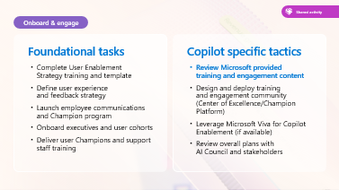
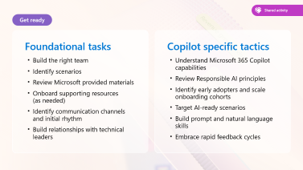
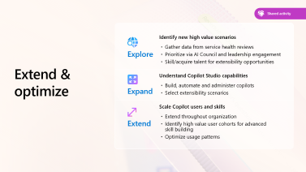
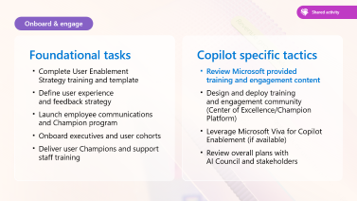
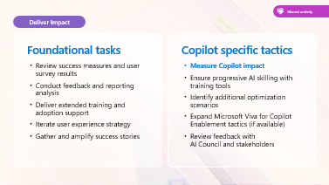
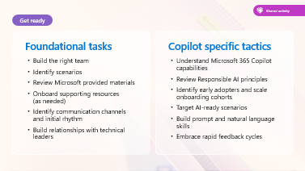
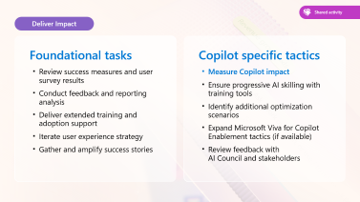
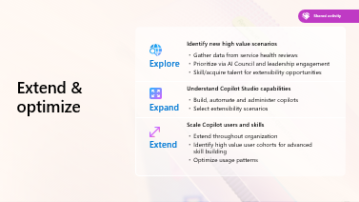
Table of contents
Notes:
The table of contents covers 4 key areas: Get ready, onboard and engage, deliver impact, and extend and optimize.
These are the 4 phases of the ‘people centric’ approach that has been designed to take you through the user enablement journey.

Slide 4
The journey to becoming AI powered
You are here
Leadership
Human change
Technical readiness
Develop leadership capabilities to leverage AI for business outcomes
Manage the human transformation with robust user enablement programs
Build and iterate technical skills to deliver on business results
Executive sponsorship
Align AI to business strategy
Providing clarity and prioritization
Best practice: AI Council
User enablement program
Communications and community
Skilling and training
Best practice: Community of Practice and Copilot Dashboard
Secure your data infrastructure
Policy review
Extend to new high value line of business scenarios
Best practice: Optimization Assessment
Responsible AI principles

Slide 5
Why does user enablement matter?
Microsoft 365 Copilot represents a new way of delivering business value, employee engagement, and creativity in your organization. To get the most from these transformational AI capabilities, an investment must be made in the human side of change. Employees seek purpose and satisfaction. Employers aim to harness worker ingenuity, and a diverse, multi-generational workforce can now work anytime, anywhere. Success depends on your ability to collaborate successfully, drive productivity, and unleash creativity within teams spread across the globe. Supporting your users in understanding these powerful tools will enable you to get the most from your investment and drive the positive transformation that AI capabilities can deliver.
We understand that adopting new technology involves change, and change can be daunting even for the most innovative, cutting-edge organizations. That’s why we created the Microsoft 365 Copilot User Enablement Guide. This guide is the partner to the Technical Readiness Guide and will reference the shared planning milestones essential in iterative project success.
From our research and real-world experience, we’ve compiled an easy-to-follow how-to that guides you and your teams,
step-by-step, through the best way to roll out Microsoft 365 Copilot to your organization and drive continuous impact across your organization. The insights we share come from our shared learnings from the implementation of other emerging technologies, our most successful customers, and User Enablement experts from around the world. Throughout this guide you will find links to additional tools and resources as well as the user enablement planning workbook where you can build your custom approach to driving true user satisfaction.
Remember, you are not in this alone. There are many organizations who are currently launching Copilot and generative AI technologies from Microsoft, and you can connect with them in the Driving Adoption Community and through our free, worldwide Microsoft 365 Champion program.
Implementing a robust user enablement program is a journey. Let’s take it together.
Notes:
There are three key messages here:
The first message is reinforcing that whilst Copilot is a technology, its real value is as a business transformation tool. In order for business benefits to be realized, people have to change the way they work, and new behaviors needs to be sustained. Technical implementation and training alone are not sufficient.
Any type of business transformation does require a change to current ways of working and this can be quite a complex and sometimes daunting challenge for the organization. Our customers need to understand that this is a significant change and will take time. Whilst a technology ‘launch’ can be an event, the people change journey continues until people have built the ability to do things differently and those new behaviors have been sustained.
And finally, you are not alone in facing these challenges. That is why we at Microsoft have provided this guidance, along with the rest of the Copilot Success Kit, to support you in your implementation of Copilot.

Slide 6

Microsoft 365 Copilot implementation
Human change
Prepare organization and employees for the AI transformation journey through user enablement programs
Copilot
readiness checklist
You are here
Workstreams support each other for maximum value and ROI
Copilot implementation
Sponsor
Scenarios
Security
Get ready > Onboard & engage > Deliver impact > Extend & optimize
Technical readiness
Address technical deployment and optimization, including governance, security, compliance, and management
Leadership journey
Notes:
When implementing Copilot, there are three workstreams to consider and they should run in parallel.
There is the technical readiness workstream which is ensuring that you have completed the necessary technical prerequisites to ensure a successful deployment.
This is covered under separate training content.
This guide focuses on the human change workstream, providing support to prepare yourself and support your users on your journey to be successful.

Slide 7
Essentials for Copilot user enablement success
Nominate and activate your Copilot executive sponsors, in partnership with your AI Council
Accelerate your business impact by defining highest value scenarios
Define your path to secure your data for compliance and peace of mind
Notes:
There are three essential requirements for a successful Copilot deployment.
These are:
An active, visible sponsor who is ultimately responsible for driving the value across the whole business.
Scenarios. This is identifying use cases and scenarios where the use of Copilot can drive maximum efficiencies and effective outcomes based on specific business requirements. Remember, Microsoft provide a list of generic scenarios, but you should talk to you customers about what is important to them, based on their project objectives and business priorities. Scenarios will most likely need to be customised based on customer specific roles and responsibilities
Security is a significant consideration for all organisations when deploying Copilot whether that be looking at data governance or compliance as well as ensuring the responsible use of AI within the business. It is important to make sure you have the relevant stakeholders engaged to understand at the earliest opportunity any challenges or considerations that need to be addressed prior to launch.

Slide 8

Implementation overview
Microsoft 365 Copilot
You are here
Get ready
Onboard & engage
Deliver impact
Extend & optimize
User Enablement Workstream
Complete User Enablement Strategy training
Define user experience and feedback strategy
Design and deploy training and engagement community (Community of Practice/Champion Platform)
Launch employee communications and Champion program
Onboard executives and user cohorts
Deliver user Champions and support staff training
Review success measures and user survey results
Conduct feedback and reporting analysis
Deliver extended training and adoption support
Identify additional optimization scenarios
Iterate user experience strategy
Gather and amplify success stories
Extend to new high value scenarios
Deliver business process transformation with Copilot Studio, plugins, and connectors
Drive group and cross-organizational productivity and innovation
Understand custom line of business opportunities
Secure exec sponsorship, create AI Council, and define RAI principles
Identify success owners, Champions, and early adopter cohorts
Detail high value scenarios and personas
Be intentional with assignment and concentrate seats
Define success criteria, KPIs, and success measurement plan
User
Enablement
Technical Readiness Workstream
Ensure appropriate Data Security controls are in place
Prepare your organization for Microsoft 365 Copilot with setup guide: deploy Microsoft 365 apps, if needed; assign licenses
Assign permissions by role to provide access to the Microsoft 365 Copilot usage report
Establish service management plan
Analyze Microsoft 365 Copilot usage reports and the Microsoft Copilot Dashboard to observe user adoption, retention, and engagement
Design, build, and publish plugins to deliver unique experiences
Build your own custom agents
Perform the Microsoft 365 Copilot Optimization Assessment
Address data security, governance, and data access questions
Build shared Microsoft 365 Copilot implementation plan with User Enablement team
Technical Readiness
Notes:
The implementation overview provides a more detailed breakdown of the two workstreams: user enablement and technical readiness. In the following slide we will focus in some more detail on the user enablement requirements.

Slide 9
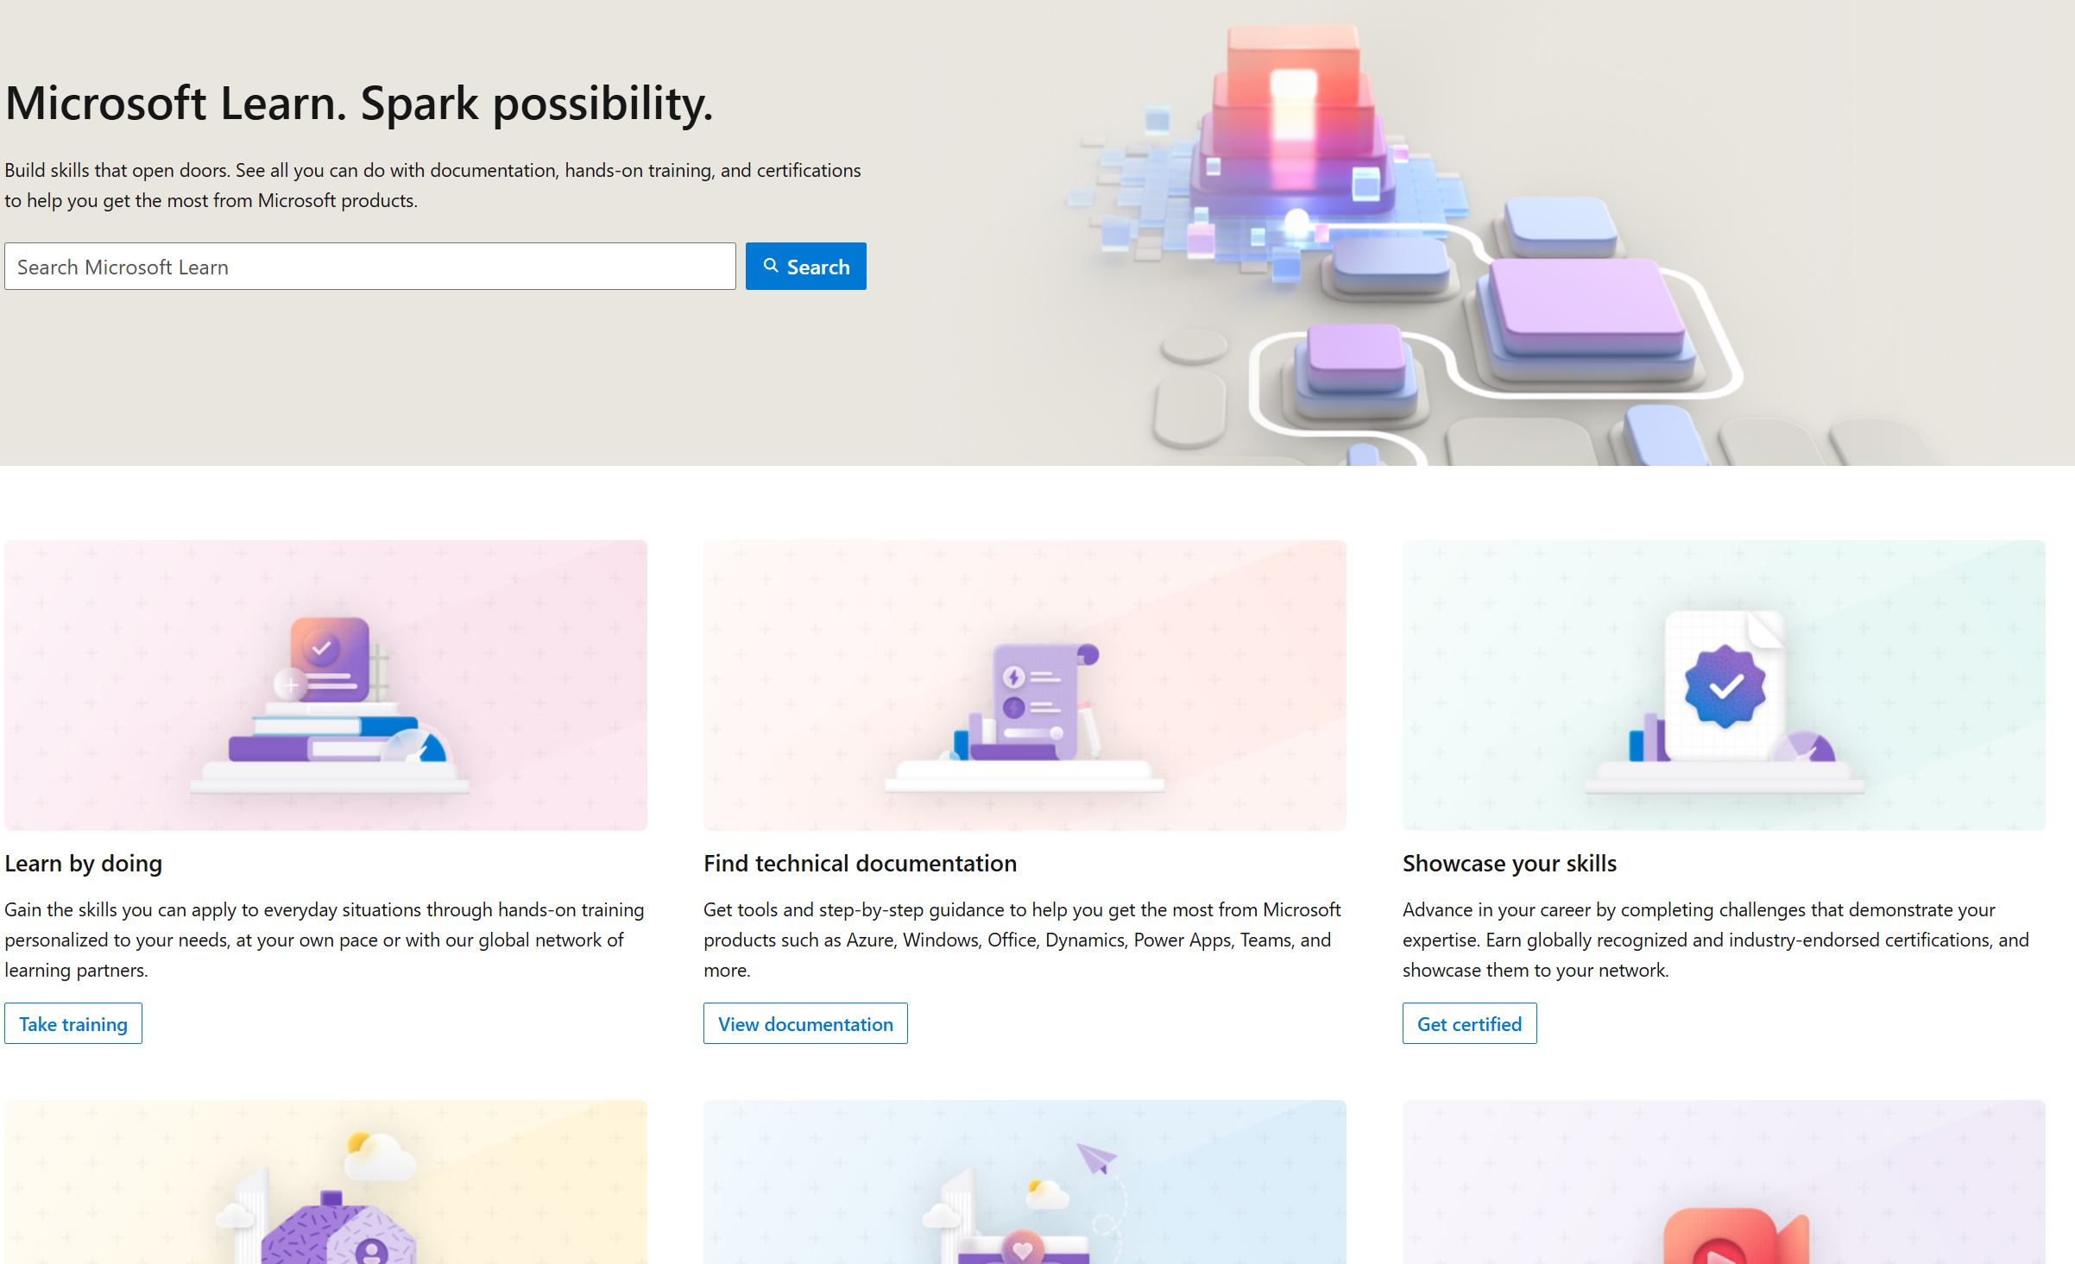
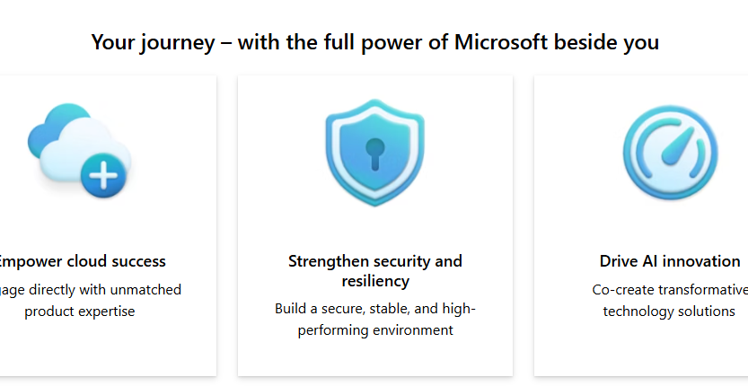
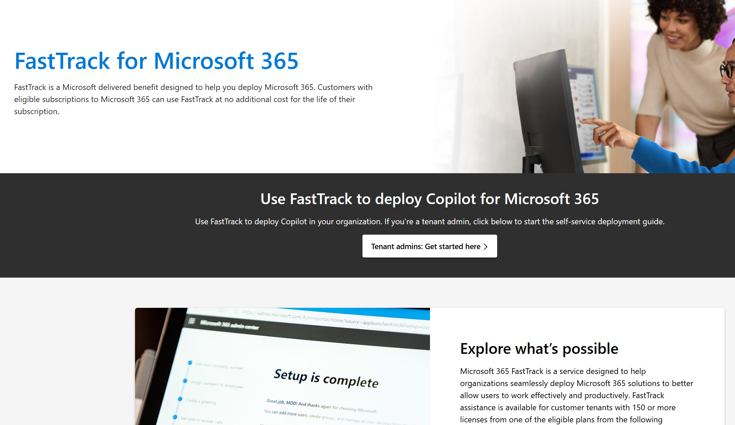
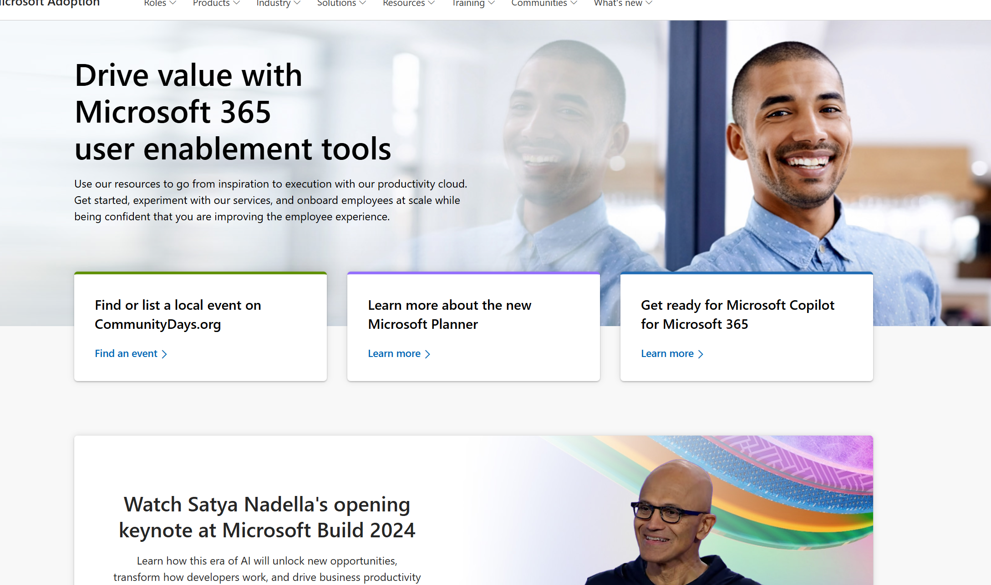
Copilot for Microsoft 365
Readiness checklist and key resources
Get ready
Onboard & engage
Deliver impact
Extend & optimize
Secure exec sponsorship, create AI Council, and define RAI principles
Identify success owners, Champions, and early adopter cohorts
Detail high value scenarios and personas
Be intentional with assignment and concentrate seats
Define success criteria, KPIs, and success measurement plan
Complete User Enablement Strategy training
Define user experience and feedback strategy
Design and deploy training and engagement community (Center of Excellence/Champion Platform)
Launch employee communications and Champion program
Onboard executives and user cohorts
Deliver user Champions and support staff training
Review success measures and user survey results
Conduct feedback and reporting analysis
Deliver extended training and adoption support
Identify additional optimization scenarios
Iterate user experience strategy
Gather and amplify success stories
Extend to new high value scenarios
Deliver business process transformation with Copilot Studio, plugins and connectors
Drive group and cross-organizational productivity and innovation
Understand custom line of business opportunities
User Enablement
Support continuous learning and optimization
Copilot learning hub
Build your skills across Microsoft Copilot with industry leading online training and certification programs.
Microsoft Unified
Unified unlocks the greatest value from your investment.
Microsoft FastTrack
FastTrack is a Microsoft delivered benefit designed to help you deploy Microsoft 365.
Microsoft resources
Microsoft Adoption
Resources to ensure you are delivering employee satisfaction and business value. Accelerate human change management with on-line resources, training and communities to make the most of your investment, all included with your subscription.
Notes:
Get ready is the first phase for any organization. Making sure that the business has secured sponsorship and identified individuals within the organization who are responsible for success as well as early adopters. Early adopters are users who are given access to Copilot ahead of a broader deployment and can be individuals who are particularly welcoming of change (or trying new technology) or can be groups of individuals where a specific use case or business scenario has been identified that can benefit from the use of Copilot. They are generally considered what is commonly known as ‘friendly users’ – typically they will provide constructive feedback directly to the project or program team and are more understanding of the fact that they are an early adopter.
It is beneficial at the earliest opportunity to identify specific (and high value) use cases where the organization can quickly realize value from the use of copilot. This is generally achieved with ‘intentional’ assignment of licensing based on a specific use case or business requirement.
Crucial to the success of your product launch at the outset is to clearly define your success criteria, KPI’s (key performance indicators) and how you will measure success. These outcomes are a necessary factor and will help to ensure that you have the full support of the business as you move into a broader deployment
At the onboarding and engaging phase, think about how you will manage training and communications and the broader engagement with your users. Think about how that training will be delivered, how that training will also be inclusive, relevant to the business requirements and is updated to reflect changes and improvements as Copilot continues to develop.
Having senior leaders and executives aligned at the early stages with a strong focus on training will reassure users of the commitment from the organization.
Delivering impact is determining how to gather and look at user feedback and how to manage and respond to that feedback. It’s also about how do you collect users’ individual success stories, or “a ha” moments, and share them broadly with the organization.
Expand and optimize phase is where you start thinking about extending to new, high value or cross-organizational scenarios, such as creating custom agents with Copilot Studio.

Slide 10
Implementation project summary
First 30 days
30-60 days
Shared milestone view
Recurring tasks
Select and validate initial cohort
Helpdesk onboarding
Review community
management plan
Launch training content and
office hours
Complete foundational learning
Assemble team
Share prioritized scenarios
Purchase decision
Triage of daily feedback
Review shared support process
Launch progressive skilling content
Prepare for and conduct Service Health Review
Summarize scenario and user recommendations
Launch extensibility skilling content
Weeks
00
01
02
03
04
05
06
07
08
09
10
11
12
Stakeholder alignment
Define comms ROB and tools
Share Optimization Assessment results
Deliver shared implementation plan
Ensure data security
controls are in place
Install apps, assign licenses
Ensure reporting roles assigned
Update support systems
Enhance Center of Excellence
Analyze usage reports and Dashboard data
Summarize risk, issues, and opportunities
Prepare AI Council insights
Notes:
This slide shows a suggested timeline and set of tasks and milestones between the different workstreams (leadership, user enablement, technical readiness). It also identifies recurring tasks. These are activities you may need to regularly undertake during the lifecycle of their deployment. You can customize this timeline and the activities to meet your organization’s needs.

Slide 11
Evaluate your user enablement capabilities
Invest in a healthy champions team, who will provide peer learning and support during the AI journey
Leverage in-product experiences to create a culture of continuous learning and deliver training in the flow
of work
Ensure a vibrant community of practice for ongoing user engagement and skill building
Notes:
Continuous evaluation of your users’ capabilities is a key factor in a successful deployment of Copilot.
Investing in a healthy champions team is crucial for several reasons. Firstly, champions provide peer learning and support during the AI journey, which helps in driving user adoption and satisfaction. They act as trusted advisors to their peers, supplementing help desk and support functions. Additionally, champions offer valuable feedback on enablement efforts, ensuring continuous improvement. By creating or extending an internal champion program, you can leverage their enthusiasm and expertise to foster a culture of continuous learning and engagement within the organization.
Leveraging in-product experiences is essential for creating a culture of continuous learning. By integrating learning opportunities directly into the tools and workflows that employees use daily, you can ensure that training is relevant, timely, and easily accessible. This approach not only enhances the learning experience but also increases engagement and retention of knowledge. It allows employees to learn and apply new skills in real-time, leading to improved productivity and job satisfaction. Additionally, in-product experiences provide valuable insights into user behavior and learning needs, enabling you to continuously refine and optimize your training programs.
Finally, ensuring a vibrant community of practice is essential for ongoing user engagement and skill building. By fostering a community where users can share best practices, success stories, and insights, you create an environment of continuous learning and support. This community then acts as a hub for peer-to-peer learning, enabling users to learn from each other's experiences and expertise. It also provides a platform for users to ask questions, seek advice, and receive timely support, which enhances their confidence and proficiency with the tools. Ultimately, a vibrant community of practice drives higher user satisfaction, accelerates skill development, and ensures that you can fully leverage the capabilities of Copilot

Slide 12
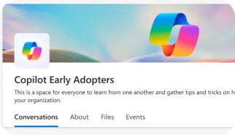
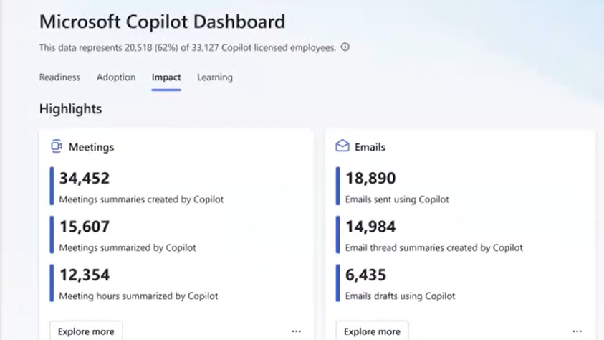
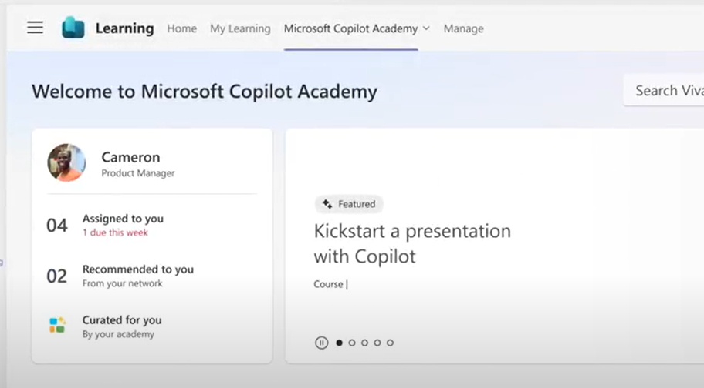

Accelerate your AI workforce transformation
Communications
Measurement
Skilling
Copilot Communities to facilitate user enablement
Share best practices
Access company announcements
Seek support from peers and IT
Copilot Analytics for ROI and impact assessment
Copilot Dashboard for leaders
Viva Insights for customizable analysis
Copilot business impact reports
Copilot Academy for user skill development
Curated learning paths
Hands-on prompt guidance
Content created by Microsoft experts
Viva Engage Community
Copilot Analytics introduction
aka.ms/CopilotDashboard
aka.ms/CopilotAcademy
Powered by Microsoft Viva
Notes:
Microsoft Viva can help accelerate your AI transformation in three areas:
Copilot communities, powered by Microsoft Viva Engage, facilitate user enablement, providing a Community of Practice for users to share their success stories and celebrate others’, ask questions, and find more training.
The Copilot Dashboard, powered by Microsoft Viva Insights, provides analytics and data on usage, as well as impact reports.
The Copilot Academy from Microsoft Viva Learning can be accessed in Teams, right in the flow of work, for user skill development and training.

Slide 13

Get ready
Shared activity
Foundational tasks
Copilot specific tactics
Build the right team
Identify scenarios
Review Microsoft provided materials
Onboard supporting resources
(as needed)
Identify communication channels
and initial rhythm
Build relationships with technical leaders
Understand Microsoft 365 Copilot capabilities
Review Responsible AI principles
Identify early adopters and scale onboarding cohorts
Target AI-ready scenarios
Build prompt and natural language skills
Embrace rapid feedback cycles
Notes:
So now we dive into some more detail around the get ready phase. Ensure you are familiar with the foundational tasks and then dig into the Copilot specific tactics that will help you ensure a successful journey.

Slide 14


Who should be involved in your adoption effort?
Transforming to this new way of working requires buy-in and support from across the business. We have identified four key groups who will bridge technology and business outcomes that matter to your organization
Each group has a specific role in implementation and should be engaged early and often. The next few pages will outline the specific role these team members will play.
1
Executive Sponsors
Success Owner
Early Adopters
Champions
Technical team
Mott MacDonald developed a network of technology champions by engaging the employees who are most interested and enthusiastic about the new capabilities. The company made sure the champions were well trained and sent them out into the business to coach and communicate with colleagues.
2
3
4
5
Notes:
Think about who will be involved in the adoption effort. As mentioned before, Copilot is not about just the technology, it's about business transformation and new ways of working. We have identified the key groups of people that need to be involved in your adoption efforts.

Slide 15
Secure exec sponsorship
  Ensure they understand the ABCs:
  Executive Sponsors should:
Executive Sponsors may:
Help the project team identify and prioritize their top business needs.
Encourage shared planning between user enablement and technical teams.
Play a role in communicating the vision to leaders across the organization.
Actively participate in and use Copilot to help drive and reinforce enablement.
Promote the enablement program. Studies show engaged employees are 2.6x¹ more likely to fully support a successful AI transformation.
Lead or participate in the organizational AI Council.
Have purchasing authority for licenses or services from supporting suppliers.
Be directly accountable for Microsoft 365 or broader digital workplace initiatives.
A
Active, visible, and consistent participation
B
Build a coalition with their executive peers
C
Communicate directly with employees to support landing the change
¹The state of AI change readiness eBook, Microsoft Viva People Science
Notes:
One of the key individuals to align is your executive sponsor. This individual will generally be a member of your senior leadership team. There is some basic, but fundamental roles that your executive sponsor needs to play in your deployment journey. The abc’s follow a simple principle about being active and visible, building a relationship with their peers at an executive level and driving the communication channel from the project or program team directly to your users. Research shows that the majority of leaders do not understand their roles in being effective sponsors of change, which can present a significant risk to the success of the Copilot User Enablement initiative.
We have to make sure that the sponsor understands that they need to be actively participating throughout the initiative and leading by example. Some examples of this could be building a coalition by talking about the Copilot initiative with all the business leaders across the organization and keeping them all on board, answering their questions, and communicating directly with all the employees that will be using Copilot, so they can understand the importance of the initiative.
The executive sponsor should be supporting the project and the change management team, working with colleagues across the business to identify core business priorities. As well as driving the communications to the business they should be seen actively using copilot on a day-to-day basis to help reinforce the message and demonstrate the commitment of the business.
They may also be responsible for the ethical side of the use of AI within the business and be directly accountable or at least have some level of responsibility for the broader use of Microsoft 365.

Slide 16
Complete Stakeholder Engagement Worksheet
Shared activity
Identify measures for stakeholder engagement:
Get ready
Level of interest
Level of organizational influence
Level of resistance
Engagement model
  Fulfill expectations
Document relationship owners and contact methods
Notes:
You need to think about how you will effectively manage stakeholders throughout not only the initial deployment of Copilot but a continued working partnership in the medium and long term. Use the stakeholder engagement worksheet, available as part of the success kit, for this activity with the technical readiness team.

Slide 17

Utilize stakeholder management lifecycle
1
Validate strategic objectives
Ensure clear mission and goals from existing executive stakeholders, AI Council or business leaders for AI transformation.
4
Understand and assess
stakeholder relationship
Using the Influence/Interest stakeholder grid, map each stakeholder based on their interest and influence over your work. Then color code each one based on their attitudes: Green=Supportive; Yellow=Neutral; Red=Critical.
1
6
2
2
Identify stakeholders
Identify all your potential stakeholders (including senior executives, peers, customers, prospective customers, etc.) who have influence over your work or an interest in its outcome.
5
Develop communication plan
Using the Influence/Interest grid, define a communication strategy/cadence for each type of user. Use this as a guide to “personalize” the communication plan for your key stakeholders to meet their individual needs.
5
3
3
Define stakeholder management
approach and actions
Using the stakeholder engagement worksheet, list all stakeholders and assess their key interests/issues; attitudes; desired support; messaging; relationship owners; and actions.
4
6
Monitor and adapt
On regular intervals, re-assess stakeholders’ influence, interest, and attitudes and modify their communication strategy appropriately.
Notes:
These are the recommended steps in order when managing stakeholders. It is critical to start with the project objectives and ensure those are articulated and agreed. The Executive Sponsor then needs to use them to get buy in with all the other business leaders within their organization.
As the various stakeholders are identified, you, the change manager should capture them on the Stakeholder Engagement Mapping Tool.

Slide 18

Understand and assess stakeholder relationships
Develop stakeholder Develop to Key stakeholder by demonstrating value Active, infrequent stakeholder management Consult in key decision making | Key stakeholder Key stakeholders, main focus Active, frequent stakeholder management Involve in key decision making
Inform stakeholder These are the least critical stakeholders Inform infrequently via general, broad-based communications | Extended stakeholder Passive stakeholder management Provide information regularly Ask for feedback Involve in low-risk work
Using the Influence/Interest stakeholder grid, map each stakeholder based on their interest and influence over your work.
Then color code each one based on their attitudes:
Green = Supportive
Orange = Neutral
Red = Critical
Influence
Stakeholder 3
Stakeholder 4
Stakeholder 1
Stakeholder 2
Stakeholder 5
Interest
Notes:
It is good practice at the early stages to assess your stakeholders. Using the example shown here you can then identify where each stakeholder may have an impact on your change journey.
By mapping those stakeholders based on their level of influence and interest will really help you to be successful and build a solid understanding of where you need to focus your efforts to drive a successful change within the organization.
Just remember that your key stakeholders can be extremely influential and in many cases are the difference between a successful or unsuccessful deployment. Always make sure that they are kept informed, updated and be sure to address any feedback in an appropriate and timely manner. Make sure the information is captured in the stakeholder mapping spreadsheet I referred to previously

Slide 19
Shared planning with Technical Readiness Team
Shared activity
Guidance
Your User Enablement (UE) Team is a component of the overall Copilot Implementation Team and includes a variety of roles. Your model may appear different based on the existing structure of your organization.
Assemble your team
Below are characteristics of successful UE Teams, which should be considered as you recruit the UE Lead and additional resources:
Understanding of organizational change management practices
Technical skills across Microsoft 365 collaboration tools
Advanced program management skills
Relevant business acumen and visibility to overall AI vision
Strong written and verbal communications skills
Ability to model desired leadership skills
Notes:
Now is the time to work on assembling your team. As mentioned earlier, the user enablement and technical readiness workstreams are required for a successful implementation. Whilst this guide focuses on the people change, it is important to understand that there are technical requirements that need to be considered. As you look to build your team, these are examples of the resources that should be considered and included either as part of the core team, or as part of your extended team. Again, these roles are very subject to change depending on the organization.

Slide 20
Identify your team members
Shared activity
Key roles | Responsibilities | Department | Team member identified for role
Executive Sponsor | Send Microsoft Launch announcement. Help identify and prioritize top HR needs. Connect monthly with HR and IT leaders across the organization. Actively participate in and use the Microsoft 365 capabilities to help drive and reinforce adoption | VP, HR | Jane Doe
Success Owner
Program Manager
Champions
Training Lead
Department Leads (Stakeholders)
IT Specialists
Communication Lead
HR Manager
Community Manager
Notes:
When identifying your team members, it's always good practice to have this documented as it provides clarity and ensures the members of the team become accountable in the wider change. This slide is an example document that you can adapt to meet your own requirements and roles. Going through this process is extremely useful as it can also highlight or identify where you may have a gap or lack of resourcing in a specific area or role. It is suggested that you spend a few minutes to get some names down for the various roles within the session. This will start to formulate the core User Enablement team.

Slide 21
User Enablement Team model
Example
WW Executive Sponsor
Unit Executive Sponsor
Sends key local communications
Appoints Business Integration Lead
Represents sponsor with core team
Monitors enablement
Works with Executive Sponsor for Communications and Cascade
Worldwide User Enablement Team
Core IT services and support
Business Integration Lead
Provide scenario-based guidance
on Microsoft 365 Copilot
Provide global package of assets to leverage (comms, training, readiness, etc.)
Provide onboarding, enablement, and
issue reporting
Consolidate feedback and share
via Service Health Reviews
Provide operations, service, and support experiences for new scenarios and features
Local Copilot Champions
Provide local support
Provide local training as needed
Example model – Implementation teams can modify as needed.
Supplier capacity may be added as needed for key activities.
Notes:
The user enablement team model is a great example of providing a visual representation of the roles of the team members and their responsibilities as part of the deployment. Once you have identified your team members, having that additional visual representation ensures that should you need to communicate roles and responsibilities to the wider business you have documentation that is very clear and visual. This can be customized based on your resource modelling.

Slide 22
A cross-functional and multidisciplinary body
It is essential for organizations to establish a governance framework that ensures the responsible and ethical use of AI across their operations and stakeholders.
AI Council
One way to achieve this is to create an AI Council, a cross-functional and multidisciplinary body that oversees and guides the development, deployment, and evaluation of AI solutions within the organization. An AI Council can help to align the organization's AI strategy with its vision, values, and goals, as well as to identify and mitigate potential risks and harms of AI. An AI Council can also foster a culture of trust, collaboration, and innovation among the AI practitioners, users, and beneficiaries within and outside the organization.
that oversees and guides the development, deployment and evaluation of AI capabilities.
Get started today
aka.ms/copilot/AICouncilSetupGuide
Notes:
It is important that the business has a documented strategy for the use of AI within the organization. There is guidance through the link on the slide on how to set up an AI council or alternatively a list of individuals or roles that should have an input into defining a strategic policy or approach. Making sure that you do have either an AI council or an approved strategy is really important. Without this there is a risk that the project or deployment could be blocked by the business which is something you want to avoid.

Slide 23

Rules
Responsible AI Standard
Records
our practice of Responsible AI by Design – the proactive ways in which we guide the design, build, and testing of AI systems
Establishes
a durable framework for the maturing practice of responsible AI and evolving regulatory requirements
Reflects
our deeper exploration of what our six AI principles mean and the steps we must taken to uphold them
Notes:
This slide shows the Microsoft responsible AI standard and there is a link to our own internal policy which is publicly available.

Slide 24
Copilot brings AI value across roles and lines of business
The anatomy of the Responsible AI Standard
Principles
Which enduring values guide our responsible AI work?
Goals
What are the outcomes that we need to secure?
Requirements
What are the steps we must take to secure the Goals?
Tools and practices
Which aids can help us meet the Requirements?
Notes:
The anatomy for the responsible AI standard follows a very simplistic approach based on four key areas. Principles what are the values that guide responsible AI. Our goals and the necessary steps we must take. What are our requirements to achieve our goals And what tools and practises help us to meet those requirements.

Slide 25
The Standard’s goals at-a-glance
Accountability
Transparency
Fairness
Reliability & Safety
A1: Impact assessment
A2: Oversight of significant adverse impacts
A3: Fit for purpose
A4: Data governance
and management
A5: Human oversight
and control
T1: System intelligibility
for decision making
T2: Communication to stakeholders
T3: Disclosure of AI interaction
F1: Quality of service
F2: Allocation of resources and opportunities
F3: Minimization of stereotyping, demeaning, and
erasing outputs
RS1: Reliability and
safety guidance
RS2: Failures and remediations
RS3: Ongoing monitoring, feedback, and evaluation
Privacy & Security
Inclusiveness
PS1: Privacy Standard compliance
PS2: Security Policy compliance
I1: Accessibility Standards compliance
Notes:
We follow 6 areas for our responsible AI standards. These are accountability, transparency, fairness, reliability and safety, privacy and security, inclusiveness. Copilot has been built with all these standards at the core of our development.

Slide 26
Onboard & engage
Shared activity
Foundational tasks
Copilot specific tactics
Complete User Enablement
Strategy training and template
Define user experience
and feedback strategy
Launch employee communications
and Champion program
Onboard executives and user cohorts
Deliver user Champions and support staff training
Review Microsoft provided training and engagement content
Design and deploy training
and engagement community
(Center of Excellence/Champion Platform)
Leverage Microsoft Viva for Copilot Enablement (if available)
Review overall plans with
AI Council and stakeholders
Notes:
We now move into onboarding and engage. This is the second phase of a successful implementation. Similar to ‘get ready’, the foundational tasks are listed on the left-handed side and tasks specific to copilot are listed on the right-hand side.

Slide 27
Craft a user experience strategy
A user experience strategy will enable you to quantify the value received from implementing Microsoft 365 Copilot.
Your technology enablement team is central to the success of your project and your employees with your technology investments.
Your user experience strategy gives them a vision and roadmap for success.
Use Microsoft 365 Copilot to create the initial draft.
1
Identify target user personas
2
Quantify pain points and potential productivity gains
3
Define engagement touch points
4
Prioritize user feedback methods and issue resolution
#ProTip
5
Define success measures and use cases
Driving enablement is an ongoing user and stakeholder engagement process. It is a lifecycle activity not a moment in time.
Notes:
A critical component of a successful implementation will be to understand and create a user experience strategy. This will help you to quantify the value that the business will receive from implementing Copilot.
Once you understand how people work today, this allows you to identify any pain points or challenges faced by the business and where you can improve efficiency and effectiveness.
Once the key areas where improvements could potentially be made have been identified, you can focus your efforts on understanding how to engage with these individuals or groups within the business to help drive forward change and improvement.
Through that engagement, it is important that you are managing and supporting feedback into the program to not only ensure that you are being successful but using that feedback allows you and the team to be more effective as you work with the wider business. It’s also important when working with users or groups that the project or program are being seen to be working with the business, recognizing their feedback and addressing any concerns or issues that may be raised.
Defining the success measures as part of the strategy ensures that you have clear and tangible outcomes. This means that you are able to demonstrate success and, in some cases, identify where you were unable to meet the outcome and where further work may be required. This also allows for lessons learned from the work that has been undertaken and can help streamline the approach moving forward.
When considering a broader implementation, being able to demonstrate success will help build confidence and encourage a broader engagement within the business.
It is important to note as highlighted on the slide that this is a lifecycle activity and not a moment in time. This means that you may need to revisit an opportunity or scenario as things naturally change over time.

Slide 28






Understanding the user journey
Getting to “Aha!”
Feel
When can
I use it?
How can
I get help?
Why should
I care?
How will
WE use it?
How does this change my experience?
How can I do more?
What’s
next?
How will
I use it?
Act
Think
The Think-Act-Feel framework is grounded in decades of research showing a whole human understanding – including feelings – is critical to business outcomes.
Building on this framework we understand that delivering accelerated change is based on trust.
How can I share
my success?
How can I enhance my profession
with this?
An aha moment is defined as “a moment of sudden insight or discovery”.
Notes:
As mentioned before, Copilot is a bit different than the experiences we have driven enablement in the past. Many of us have launched large and small technology projects but we all have a failed technology project where the technology didn’t deliver what was promised, and that’s where the trust gets eroded. We have an opportunity now with Copilot to rebuild trust yet again. This means that we can rebuild the trust that the user has in that the system will help them to get the most of what’s been put in front of them. Our job is creating that trust and enthusiasm at scale and helping people get to what we refer to “aha” moments. This is the moment where an individual gets it, where they understand how the technology can help them.
This slide documents and charts, based on decades of research done at Microsoft and the collective 100 years of experiences of user enablement people around the world, the unarticulated questions that most users are asking when faced with new technology or change. We can talk about the benefits and value of new technology, but until someone has that personal experience that understands why it matters for them, frankly it’s all talk. They really want to know why should they care.
The interactive Copilot Scenario Library (https://aka.ms/Copilot/ScenarioLibrary) is critical to the user journey because you can use it to answer the “why should I care” question, to show users specific examples of how this new technology can help them be more productive in their role.

Slide 29
Keys to user enablement success
Research results below support suggested approach for building
your adoption plan.
Top reported activities for driving successful product adoption*:
% of respondents that rated activity as having above average importance
1
Define a vision and identify how target product will be used
2
Obtain proactive support from key roles to accelerate use of Copilot including senior leadership, legal, ITDMs, and key BDMs
3
Enable Champions and provide business relevant, snackable,
and on-demand training for business users
4
Raised awareness through launch event and omni-channel communications planning
*Results of a related Microsoft research study survey
Notes:
If we take a moment to reflect back on the previous slides, we start to understand the important of the user journey in driving a successful change program. Highlighted on this slide are the top four categories or areas that should be considered as important for the business to consider as part of their deployment. Defining the vision and identifying how the target product in this scenario copilot gives users a clear understanding of how copilot can and will be used effectively within the organization. We have talked previously about the importance of key stakeholders to reinforce the commitment from the business to not only introduce Copilot but supporting its rapid deployment. Points one and two are both seen as adding significant value. The introduction of change champions, in alignment with relevant training material and a great communication strategy are also both again seen as crucial for a successful implementation.

Slide 30
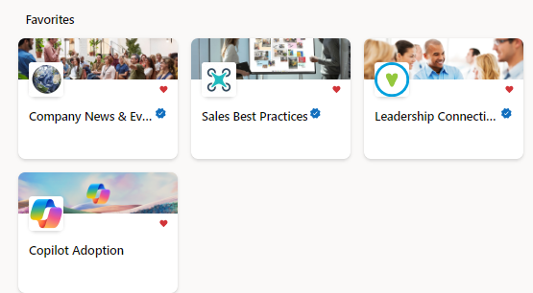
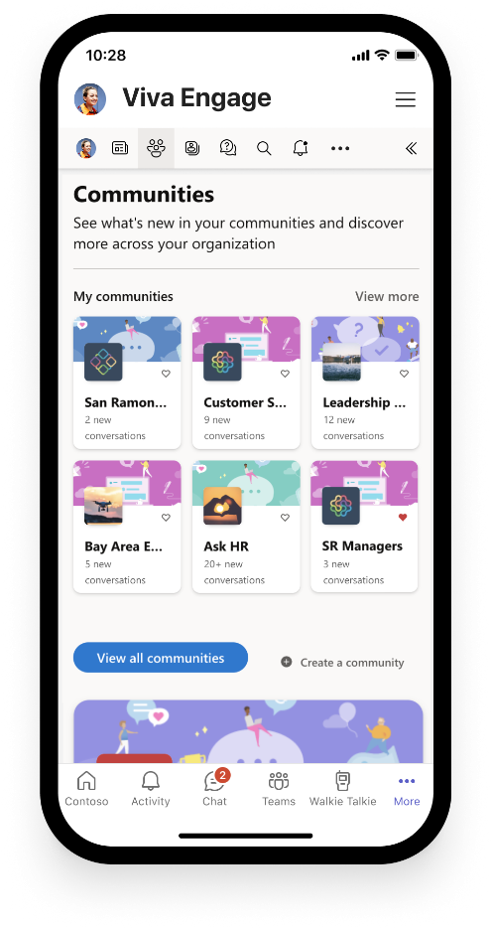
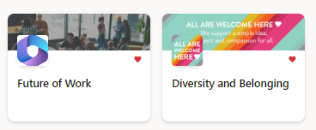
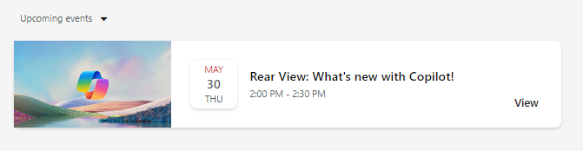

Build your Community of Practice with Viva Engage
Connect and empower employees
Create a community in Viva Engage to generate excitement, share learning, and support Copilot Champions and experts.
Give employees a place to:
Share best practices, such as prompts
Share success stories of Copilot saving time and driving productivity
Access company announcements on AI usage, direction, and mission
Facilitate peer to peer learning and Champion engagement
Get ready
Onboard & engage
Deliver impact
Extend & optimize
Notes:
NOTE: Viva Engage is recommended for enterprise customers already utilizing Viva Engage in their environment. Small/medium businesses may opt to hold this essential employee engagement in Microsoft Teams or other community chat tools.

Slide 31

Identifying user cohorts
Shared activity
Selecting the right participants for the Early Adopter Program
is key to gain valuable insights and inform the organization-wide launch. For success, a much larger group of employees should be selected for Copilot onboarding than in other service enablement plans. This allows for organic knowledge sharing,
rapid feedback, and success at scale*.
The list below describes the types of employees to include in your program:
  Users primarily from the same lines of business or departments, preferably those who work together on a project or business process.
  Likely Champions or leaders who will become advocates during the broad launch to the entire organization.
  IT and help desk team members who will support users
  during launch.
  Important: Executive onboarding is a distinct category of business user with different needs and requirements. Plan for dedicated learning time and feedback cycles from these users.
  *Based on observation and research from early Copilot customer implementations.
Notes:
We have talked a lot around user personas, business value, and realizing the benefits of copilot. It is key that you gain valuable insights ahead of an organizational launch or deployment, and it’s best practise to identify users as part of an early adopter program. These are typically groups of users who will be given early access to copilot to gain valuable feedback and help inform key decisions around deployment approach and methodology. Typically these would be groups of users rather than individuals as what we are trying to identify ultimately is where copilots is not only supporting users on an individual basis but is able to drive maximum efficiencies across a functional area within the organisation.
Other early adopters could be seen as change champions or senior leaders who will be actively reinforcing positive messaging during redeployment.
It is important that members of the IT and help desk are also given access as they are likely to be supporting users during the launch.
Particularly with Copilot, the business executive team are always very keen to be early adopters, but they can be a very complex user. In many circumstances, they will be aligned to an executive assistant or colleague. It is therefore important that they are considered as their own user type or persona and will likely require dedicated support and training. It is important that you insure there is allocated resource and time to support them.

Slide 32
Create or extend your Champion program
Peer to peer learning is a powerful tool for user enablement. Leverage this skill in your organization by creating or extending an internal Champion program.
Champions will supplement your help desk and support systems, acting as trusted advisors to their peers. They will also provide valuable feedback on your enablement.
Use our step-by-step guide to empower your Champions today.
Microsoft 365 Copilot capabilities will inspire you to transform existing business processes and drive innovation across employee experiences.
Notes:
Having an internal Champion program can help accelerate your time to value with any new technology, and that is especially true of Copilot. Follow our guide to create your own program. Join the worldwide Microsoft 365 Champion program’s monthly community calls to gain further insights, content, ready to use assets, and access to Microsoft subject matter experts: https://aka.ms/M365Champions.

Slide 33


Who are Champions?
Champions provide peer learning, early feedback, and organizational support throughout the user enablement lifecycle. They are motivated by helping others rather than the technology itself and often are an ongoing source of high value scenarios. They build awareness, understanding, and engagement throughout the community as a trusted resource to their peers.
Champions will help to:
  Create the groundswell of enthusiasm that grows adoption.
  Build a circle of influence among their teams.
  Bring the new ways of working to life across teams.
  Identify business challenges and possible solutions.
  Provide feedback to the project team and sponsors.
  Reduce strain on core project team through active, ongoing engagement.
We connect with an adoption Champion in each business unit, who sends out weekly emails on Office 365. Each Office 365 tool has core benefits and by taking users on a smooth journey through them, we are able to unlock the value in each one.
Nick Lamshed
Change Consultant, Qantas
Notes:
Your Champions should consist of representation from all areas of the business that are able to feed directly back into your project or program. These are key individuals that really understand how each area in the business truly functions and can provide real-life scenarios and business challenges that they experience on a day to day basis.
Having a Champion that works directly in that functional area and the knowledge that they have is extremely valuable. As such, you must leverage their knowledge and expertise to help drive your broader deployment. As well as providing valuable insights and feedback from the business, they will typically also be advocates of Copilot and often will act as a first line support function for users within their functional area or department.

Slide 34
Build a sustainable
Champions community
  Champions:
1
  Should be formally trained to increase their depth and breadth of knowledge.
  Champions help build, grow, and sustain your Copilot implementation by gathering feedback, supporting the human change lifecycle, and providing peer to peer guidance.
2
  Should be encouraged and empowered to guide, teach, and train their peers.
3
  Need consistent positive reinforcement that affirms the impact of their efforts.
4
  Need a clear plan upon which to execute.
Notes:
Building a change champion community comprises of four key areas to consider.
It is important that Champions should be formally trained, usually by the project or program team, and ideally as a community of Champions. That way not only do they feel empowered as individuals, but they also become a community within themselves that promotes collaboration and a sense of togetherness. Often it is the case when working within a Champion community they will be sharing ideas and best practices with other colleagues which can only prove to be beneficial.
As part of their training, Champions should be encouraged and empowered to be supporting their colleagues and identifying business challenges and scenarios from within their functional areas.
When a Champion either volunteers or is nominated from within their department, the positive impact that they will have needs to be recognized formally. You must make it clear that these individuals will need dedicated time away from their day-to-day activities to undertake training and to support their colleagues during the launch.
This is why you need to make sure there is a structured plan and clarity around the role, the time implications, and a clearly defined set of activities that they will need to undertake.

Slide 35

Five steps to developing a Champions community
1
  Set the context.
2
  Align the Champions community to organizational objectives and vision for your Copilot implementation.
3
  Identify Champions and get buy-in.
4
  Build a plan with Champions. Skill them first and often.
5
  Execute and share Champion feedback with leaders and through Service Health Reviews.
Notes:
There are five steps to developing your champions community.
Set the context, be clear on the project objectives on the role that the change champions will play in the launch.
Make sure that the Champions are aligned to the business objectives and outcomes the key success criteria and the business objectives for your copilot deployment.
When identifying your champions, a a great way to do this is to contact your HR department and ask them to identify all the functional areas that exist within your business. In an ideal world it would be great to have representation as a change champion from each of those functional areas. This will ensure that you are gaining real world insight and true representation from the business as a whole. Ideally you are looking to recruit champions who are keen to be involved rather than an individual who has just been nominated but is not necessarily eager to be a part of the project.
We cannot emphasise enough the importance of Champions in helping you to be successful, so it is crucial that you are building a plan and taking on board their feedback. Make sure that they are upskilled before other colleagues, and they are receiving regular training as the technology develops. It is key that they are seen and respected by colleagues As true ambassadors.
Their feedback is critical as this will be coming directly from the business and ensure it is taken into consideration and fed back to senior leaders and sponsors. In some circumstances this might lead to adopting a new approach during the deployment, but if you are taking feedback directly from the business and acting upon it, this can only serve to be a positive outcome.

Slide 36
The Champions program checklist
  Find enthusiastic Champions who can commit time and effort.
  Design a program to engage and recognize their effort, such as providing privileged access to relevant events or speaking engagements.
  Build a Viva Engage or Microsoft Teams Group
  for Champions to share updates and successes.
  (See our Build Your Experience and Microsoft Viva for Copilot Enablement guides).
  Communicate to individuals about the Champions role and where they can be found – remember, they are not an IT support function but business representatives.
  Provide materials ready to support their work on the group with teams and individuals (e.g., lunch and learn sessions).
  Incorporate Microsoft 365 training resources into your own internal training site.
  Ensure a regular rhythm for discussions with the Champions on what’s working and what’s not.
  Create a contest (e.g., scavenger hunts and giveaways) between departments to encourage people to interact with Microsoft 365.
Notes:
The Champions checklist provides a starting list of actions and activities for when you start setting up your Champion program.

Slide 37
Branding your
Champion program
Copilot Champions may be referred to with terminology that is in alignment with your company culture.
Champions are professionally referred to as User Enablement Specialists.
Microsoft Partners can aid you in creating your internal user enablement function.
Champion recognition – in the form of badges for engagement, Praise via Viva Insights, or other forms – are essential to Champion morale.
As advocates for the employee experience, regular feedback, employee engagement, and communications are required for role success.
Champion duties are a part of the day-to-day duties of the employee alongside their core job function.
Representation from across the organization ensures balanced viewpoints and early identification of risks and issues.
Notes:
Your Champions play a key role in ensuring that your implementation plan is a success, so it’s important formally recognize them for their efforts. This doesn’t necessarily mean a monetary recognition. You can use our Champion Management Platform, a toolkit designed to help you manage, scale, and inspire your teamwork champions to achieve more: https://aka.ms/M365CMP.

Slide 38

Make a difference
Become a Champion
Get more from Copilot and Microsoft 365
Help others do the same
Expand your knowledge and enhance your career
Join the free program at aka.ms/M365Champions
Notes:
Once your Champions have been identified, make sure they join the worldwide Microsoft 365 Champion program so that they can get continuously get skilled up and gain access to Microsoft subject matter experts and resources. Join here: https://aka.ms/M365Champions.

Slide 39
Identify and prioritize your scenarios
Shared activity
Utilize the following scenario worksheets to complete your own investigation to locate AI-ready scenarios.
The following slides will identify the business areas that are AI-ready for transformation, then work through the prioritization exercise.
Leverage this content to develop key messaging in your awareness and training engagements.
Microsoft 365 Copilot capabilities will inspire you to transform existing business processes and drive innovation across employee experiences.
Notes:
Continuing with onboard and engage, we pivot to identifying and prioritizing scenarios and developing communication and training plans.

Slide 40
AI transformation roadmap
Example
 | Quick wins 0 to 1 month | 1 to 2 weeks | 2 to 3 weeks | 4 to 6 months | 12 Months
Scenario 1 | Purchase 1,000 seats of E3 and Teams Premium and deploy Copilot to the first set of employees | Introduce Copilot in Teams and Outlook | Deliver training sessions employees on Copilot and Teams Premium | Integrate LOB app to Copilot with custom plugins | Build your own copilots
Scenario 2
Scenario 3
Notes:
Use this worksheet to define scenarios for AI transformation. Consider each scenario and how and when you would complete different steps along their journey.

Slide 41
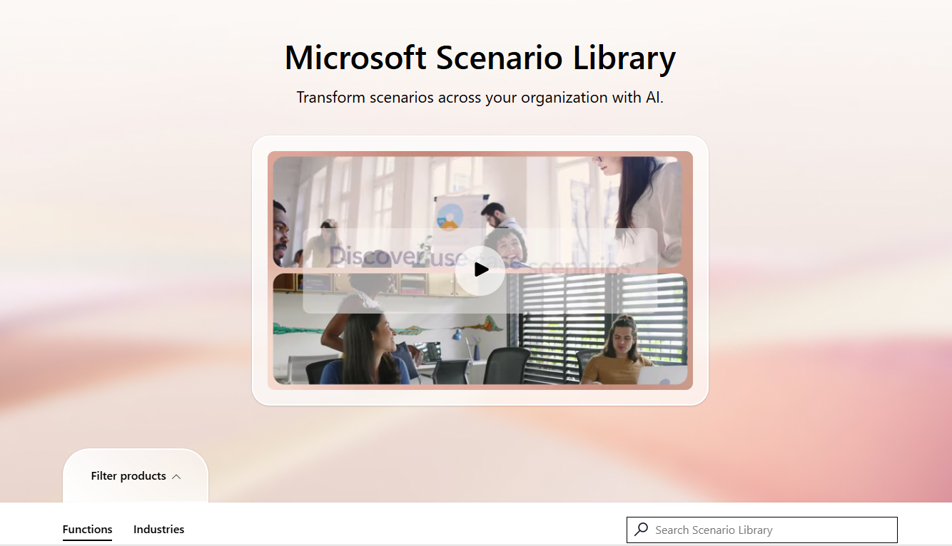
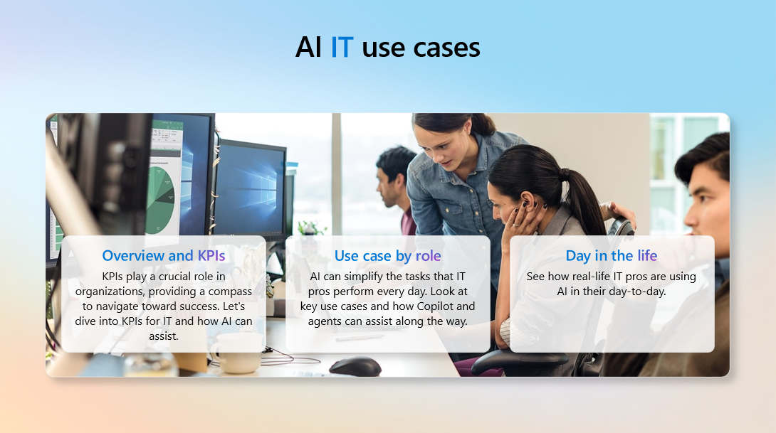
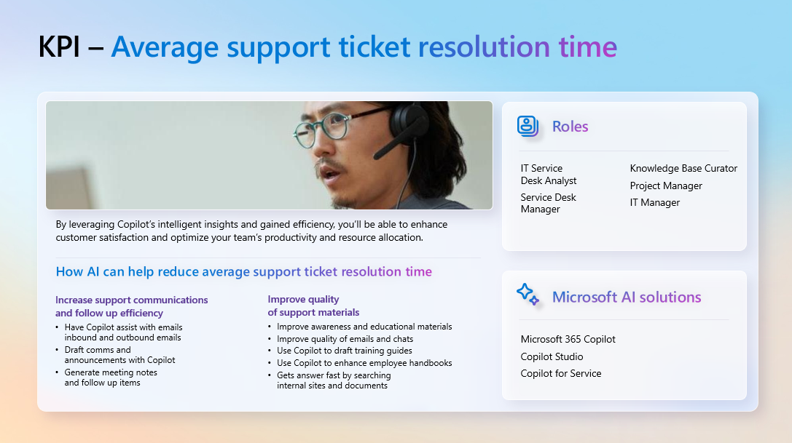
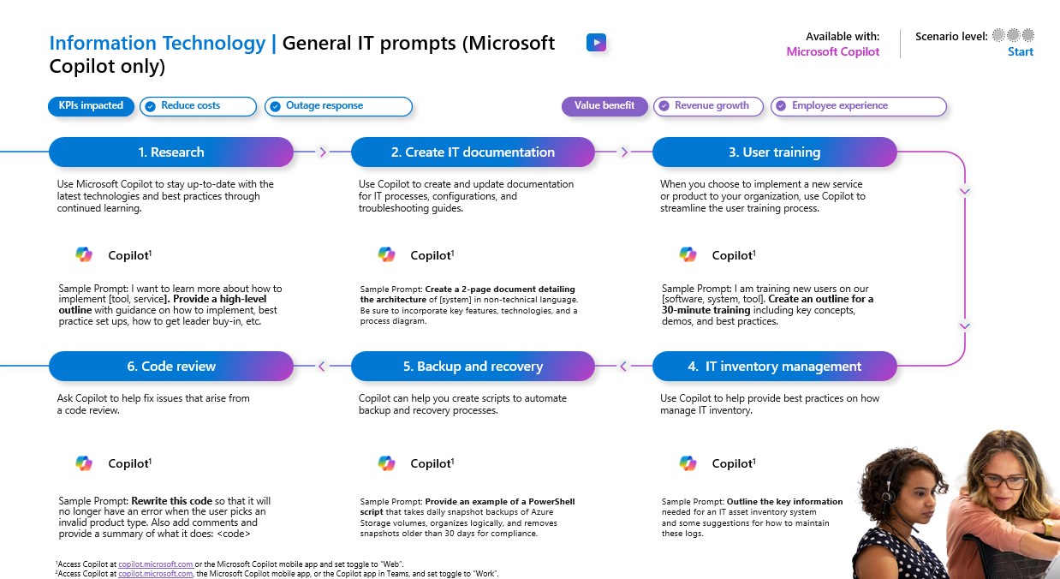
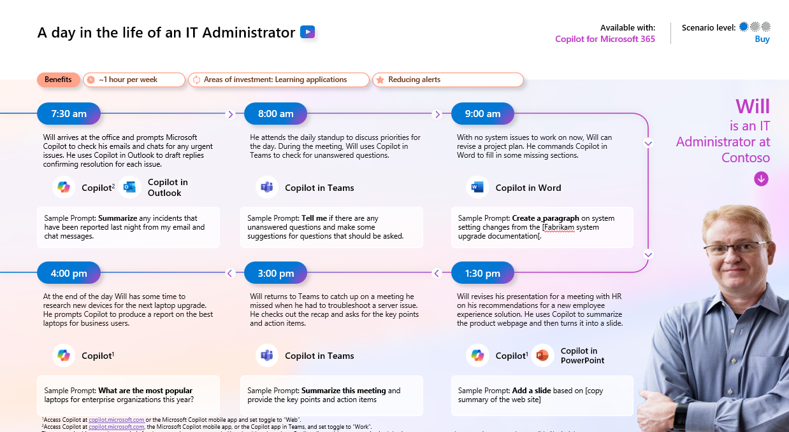
Functional scenario guidance
Utilize our interactive scenario library to start the conversation with business users about their pain points, opportunities, and ideas: aka.ms/ScenarioLibrary.
  Interactive library
  Downloadable guidance
Notes:
Leverage the interactive Copilot Scenario Library to help find and define specific user scenarios for your early adopters and organization.

Slide 42

Be intentional with seat assignments and define success criteria
Onboard & engage
Copilot brings AI value across lines of business
1
Review which departments have the highest Microsoft 365 usage data, starting with Teams meetings and PowerPoint​.
2
Concentrate licenses across entire teams or departments to start​.
3
Use the Scenario Library to identify top use cases and the key metrics you would like to improve in that functional area​.
All roles
HR
Marketing
Operations
IT
Sales
Finance
Improve meetings
Content creation
Manage daily agenda
Summarize information
Generate ideas
Cost per hire
Employee turnover
Compliance risk reduction
Benefit usage
Onboarding time
Leads created
Brand value
Cost per lead
Customer retention
Product time to market
Supply chain efficiencies
Outstanding support tickets
Application downtime
Departmental spending
Number of opportunities
Close rate
Revenue per sale
Customer retention
Time to close
Accelerate cash flow
Spend on ERP system
Risk reduction
Departmental spending
Notes:
When considering license assignment, review which teams have high Microsoft 365 usage, including Teams meetings and PowerPoint. Often those are going to be the users that get the most value as they're already in Microsoft 365 every day.
We recommend you target critical mass and concentrate licenses across an entire team or line of business.
Again, use the scenario library to help determine use cases by department that can help your organization determine overall success criteria and if there are specific success criteria for each group.
There are some suggestions here which can help you with those definitions.

Slide 43

Creativity scenario examples
As a knowledge worker, I’d like to…
Provide the impact of
a campaign in a visual format
Create a presentation based on a word document
Generate a summary about a document
Help me write
a paper on a topic
I know little about
Review my HR Benefits
Have Copilot help me write a draft email about a topic I am not too
familiar with
Give me insights
on my data
Get a new coworker up to speed quickly
Create a job description or review a resume against a job plan
Notes:
Scenarios you may consider are creativity, productivity, and skills-based scenarios.
Some examples of using Copilot in a creativity scenario include prompts which generate or create visuals, summaries, and drafts based on topics, documents, or ideas.

Slide 44

Productivity scenario examples
Track progress
through task list reports
Create a table
of pros and cons for a topic
Highlights of
a Teams chat with actions
Respond to a customer’s email in Outlook with a different tone of voice
Identify the decisions made and suggest next steps
for a meeting
Summarize emails missed while on vacation and flag important items
Save time by helping me search across my org for information
Create a Teams channel to respond to an urgent issue
Actively ask for details and insights on a document
Create a SWOT
analysis of
a topic
Notes:
Some examples of using Copilot in a productivity scenario include prompts which help us be more productive, such as tracking progress, responding with an appropriate tone, summarizing emails and documents, and identifying and creating things which save time and energy, allowing users to focus on the task at hand in a more effective way.

Slide 45

Skills scenario examples
Summarize emails, chats, and documents about a customer
Provide coaching on generating email replies
Generate a RACI chart or other PMP skills
Provide a gap analysis between documents
Create an RFP response with minimal effort
Determine upcoming milestones on a project
Ask about what a coworker
or team member has been working on
Provide details
on a project as
a new member
on the team
Review business results and summarize key trends
Analyze a complex sales report
Notes:
Skills scenario prompts are based on using or acquiring specific skill sets for efficiency. Understanding users and how they work will help guide you and your Champions to discovering scenarios and creating Copilot prompts which align with your business.

Slide 46
Build your communications plan
Shared activity
Before building your engagement plan, take time to understand who needs to be informed, key messages to convey, and preferences for communication channels.
Notes:
Now that you’ve created your Champions program and defined business scenarios and are ready to enable users, let’s discuss a communications plan.
First step is to take time to understand who needs to be informed, what the key messages you want to convey, and the organization’s preferences for communication channels. It would be good at this stage to align with the company communications team if you have one.

Slide 47




Objective:
Build daily AI habits and employee satisfaction
Shared activity
Awareness
Engagement
Measurement
Management
  Land AI transformation vision
  Tailor content by audience, scenario, persona, and usage journey
  Copilot Champions launch
  Internal testing for some
  Deliver strategic engagements by
  org and role
  Ongoing partner and employee education
  Showcase successes
  via #CopilotStories
  Conduct ongoing feedback surveys
  Usage, support, and health metrics inform baseline for enablement journey
  Drive listening systems engagement
  Improve employee guidance
  Identify additional scenarios for AI transformation
  Improve the experience from employee feedback
  Deliver integrated service roadmaps
  Iterate messages and tactics bi-monthly
  Provide employee insights signals in
  Service Health Review
Land the message
Support the change
Analyze and adjust
Improve the experience
Notes:
Landing and expanding awareness and the AI vision can be broken down into these four pillars:
Awareness – landing the message. Consider your vision, your audiences, and the scenarios aligned to each. Launching with Copilot Champions first is key to ensuring that your program is a success. Make sure your Champions understand that they are not a support function but are truly representative of the wider business.
Engagement – understand the importance of supporting the change internally. Strategic onboarding and user enablement, ongoing education (either internally or with a partner), success stories, and feedback surveys are all ways leadership can support the change.
Measurement – analyze the data and metrics in the Copilot Dashboard and survey results to adjust their strategy as needed. This gives a baseline allowing organizations to listen, engage, improve guidance, and identify additional scenarios for AI transformation.
Finally, there’s Management – the opportunity to improve the user experience based on learnings and feedback. You will also want to deliver integrated service roadmaps and continue iterating communication and providing employee insights in their Service Health reviews.

Slide 48
Lay the foundation for continuous learning and an intelligent progression of AI skills
Human change
3
Advanced
skills
Generate synergies across departments with extensibility
Streamline and automate cross-business process flows
Org value
2
Departmental skills
Departmental value
Use role-specific and multi-step prompts
Extend usage to role-based processes
1
Foundational
skills
Inspire quick wins to reach value tipping point
Master basic prompts (e.g., summarization, revision)
Individual value
1
Start with top 10 prompts that deliver immediate success (e.g., summarize a meeting, email thread)​.
2
Use the Scenario Library
to train users on new departmental use cases and process improvement to impact departmental KPIs.
3
Extend to line of business systems to streamline and automate for organizational level impacts on revenue and costs.
Prioritize peer-to-peer learning through community engagement and knowledge sharing.
Notes:
It's important to set the right foundation for driving value and setting expectations because your users are going to want to understand, “What is the impact? What is the ROI?”
We all start with Copilot value at this first level – what we call individual value or foundational skills. These are the skills such as summarizing your meetings, revising your Word drafts, etc. – things that help all users, regardless of what their job or function is.
Once you get pretty good at that, you move to the next level where you start digging into departmental or job-specific prompts, such as multi-step or multi-turn. This is where users start to feel like they're really getting high value out of Copilot.
Finally, there's the org value, or advanced skills, where people start to streamline and automate some of those business flows. There are huge gains here and by the time you get to the third level here, the ROI is very apparent about the value and the gains that you’re seeing.
Make sure that you're setting the right expectations for this journey of intelligent progression of AI skills.

Slide 49
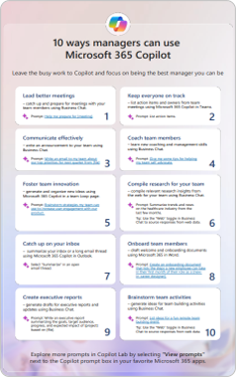
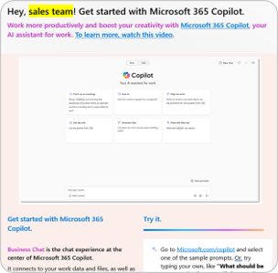
Engage your users
We’ve developed a collection of tools and templates for you to get your organization excited about Copilot and quickly realize the full benefits. It includes:
User email templates
Customizable, role-specific email templates for users in:
Sales
Marketing
IT
Legal
Finance
HR
Manager resources
Resources to send to managers across your organization to inspire and motivate them to drive Copilot user enablement on their teams. Includes:
Customizable email templates
Copilot for managers flyer
And more!
Available at aka.ms/UserEngagementTools
Notes:
We’ve developed a collection of tools and templates for you to get your organization excited about Microsoft 365 Copilot and quickly realize the full benefits. Included are user-facing resources and campaign templates for running your own Copilot onboarding and engagement activities. The content is designed to be customized to suit your organization’s needs.
Use these assets to help you achieve the goal of making Copilot a daily habit among your organization.

Slide 50





Top 10 to try first with Microsoft 365 Copilot
Foundational skills for new users
1
2
3
4
5
Recap a meeting
– let Copilot keep track of key topics and action items so you can stay focused during the meeting and avoid listening to the recording after.
Summarize an
email thread
– get quickly caught up to a long, complex email thread.
Draft email
– personalize the tone and length.
Summarize a document
– get right down to business by summarizing long documents and focusing
on the relevant sections.
Tell me about a topic/project
– provide insights and analysis from across multiple sources to get up to speed quickly.
Draft an email to [name] that informs them that Project X is delayed two weeks. Make it short and casual in tone.
Draft an email with notes and action items from meeting
Click on the Summarize icon
Give me a bulleted list of key points from file
Tell me what's new about topic organized by emails, chats, and files?
6
7
8
9
10
Give me some ideas for …
– boost your creativity with ideas for your work such as agendas, product names, social media posts, etc.
Help me write …
– jumpstart creativity and write and edit like a pro by getting a first draft in seconds.
What did they say …
– when you vaguely remember someone mentioning a topic, have Copilot do the research.
How do I …
– let Copilot help you build or fix formulas in Excel.
Translate a message
– with business becoming increasingly international, it’s important to be able to read or write messages in other languages.
Suggest 10 compelling taglines based on file
Generate three ways to say [x]
What did person say about topic
How do I sum values that are greater than 0?
Translate the following text into French:
For more prompts, visit the Copilot Prompt Gallery at: aka.ms/prompts
Notes:
This is a great handout to share with users to help them get those early wins because we know that these prompts and these types of tasks delight users and they work well.
Share: https://aka.ms/Copilot/Top10TryFirst

Slide 51
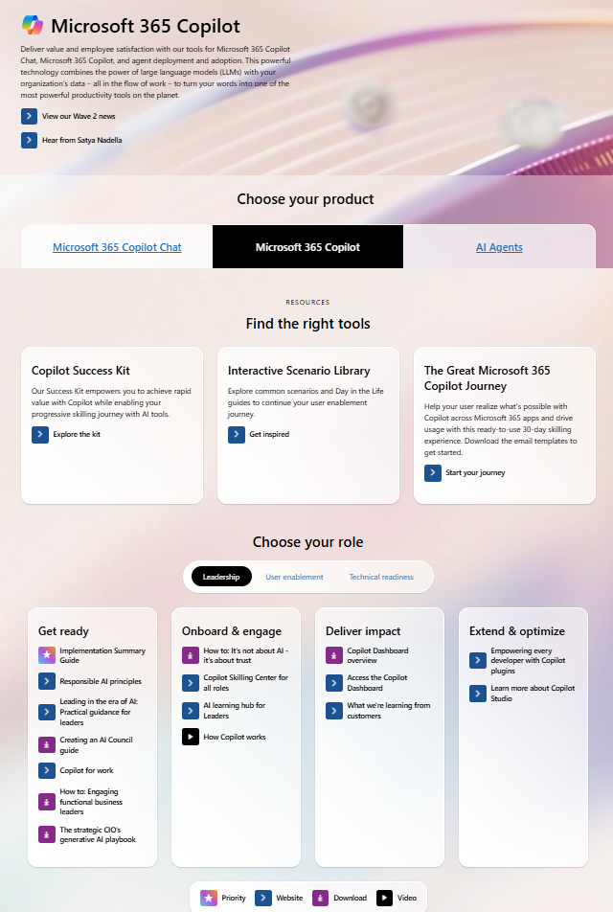

Copilot resources on Microsoft Adoption
One site for all your Copilot needs: adoption.microsoft.com/copilot
Resources by role
Interactive Scenario Library
Product announcements and news
Links to all other Microsoft sites
Extended links for Small/Medium business, Copilot in Sales, Microsoft Viva, and more
Take the class!
Earn your User Enablement badge & validate your skills with MS-4007 available today!
Notes:
Our one-stop shop for all Copilot enablement materials is adoption.microsoft.com/copilot.
This site provides resources by workstream, such as leader, user enablement, and technical readiness, to help deploy, use, and scale Copilot.
It showcases what’s new in Microsoft 365 Copilot and upcoming community events.
This site invites users to explore what’s possible with additional Copilot resource links, such as building prompt skills, creating content, joining the community, as well as other Copilot experiences.
The site content is continually updated as Copilot continues to develop, and additional functionality is added.

Slide 52
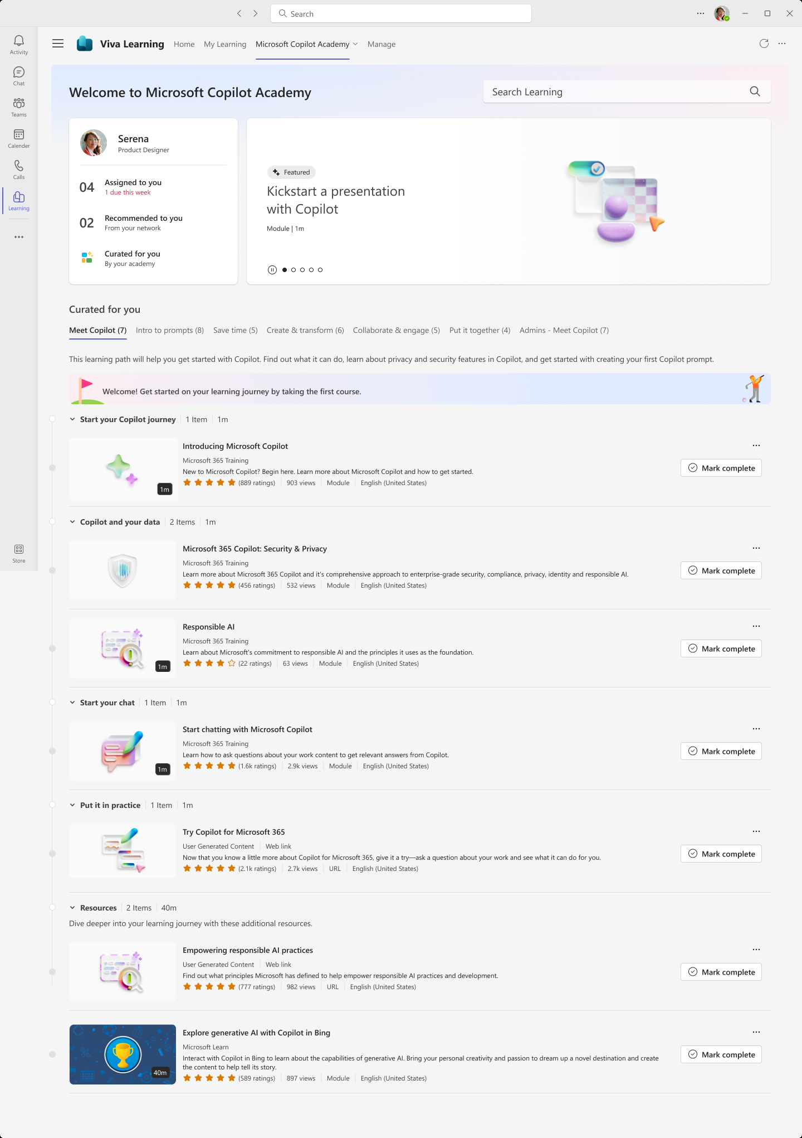
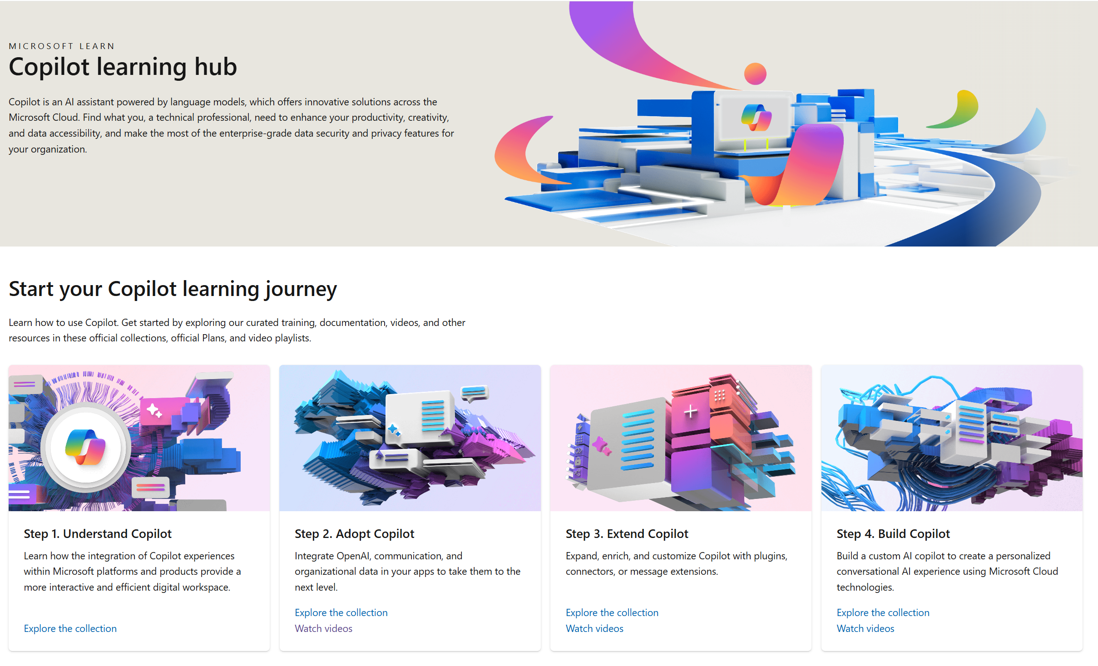
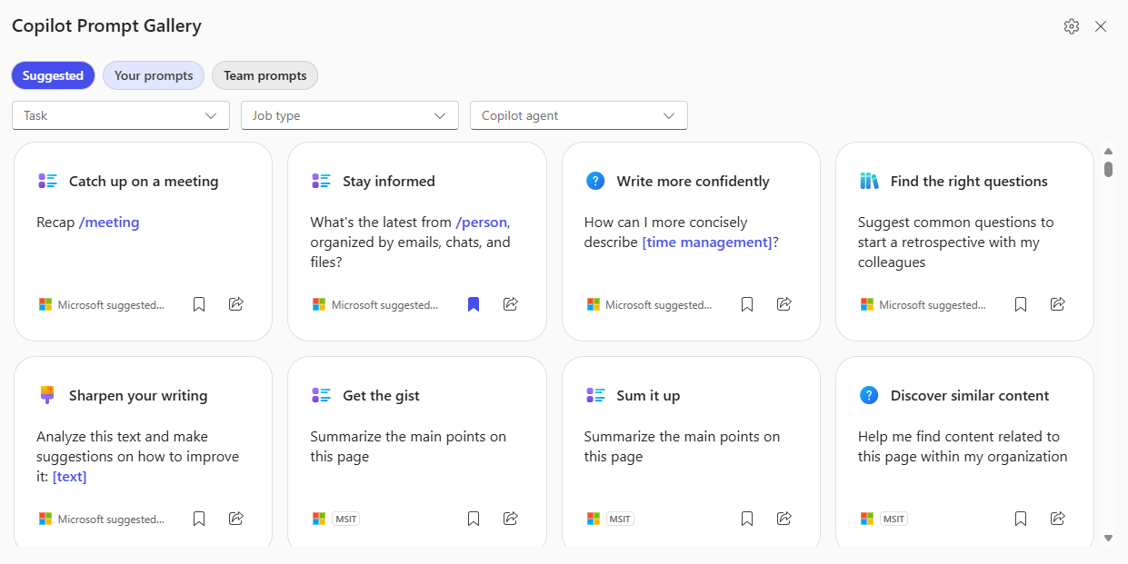
Skilling experiences
Microsoft 365 Copilot
Microsoft
Copilot Academy
Available to all Microsoft 365 Copilot customers
Centralized location to help with the basics of Copilot learning and upskilling, pulling the best content from available free Microsoft sources
Structured content in easily consumable learning paths curated
by Microsoft experts
Develop your AI interaction skills from your Viva Learning app
in Teams or webapp
Microsoft Learn
Free, on-demand training content
for skill development
Step-by-step exercises guiding learners through common Copilot prompts and use cases
Copilot Prompt Gallery
Location to learn about,
the capabilities of Copilot
Improve your prompt engineering skills in an interactive hands-on environment
Downloadable assets for customization available at adoption.microsoft.com/copilot
Notes:
This slide shows the top skilling experiences for Microsoft 365 Copilot:
Copilot Academy is a free training tool built on Viva Learning and available directly within your flow of work for all types of users. It is a centralized location which pulls in the best Copilot learning content into structured, consumable learning paths curated by Microsoft experts.
Microsoft Learn is another free web resource for self-paced, on-demand training content and step-by-step exercises for users. The training content here is skewed towards more technical audiences.
Finally, there’s Copilot Prompt Gallery, a free library learn about and test out Copilot prompts and capabilities. This is an interactive environment great for users who learn by doing.

Slide 53


Copilot Academy
Skilling
Develop the skills to utilize Copilot experiences effectively
Curated learning paths designed by Microsoft experts to help you learn about, discover, and use Microsoft 365 Copilot
Access directly at aka.ms/CopilotAcademy
Surface free Copilot learning courses in the tools and platforms where users already spend their time
Includes hands-on prompt guidance from Copilot Prompt Gallery to develop prompt engineering skills
Out-of-the-box academy is preloaded in Viva Learning – no admin configuration required
Available in 8 languages

Slide 54
Copilot Communities
Communications
Out-of-the-box Community of Practice to drive Copilot awareness and user enablement
Use the new Copilot community template in Viva Engage to quickly generate excitement, share learning, and support future Copilot Champions and experts.
Give employees a place to:
Share best practices, such as prompts
Share success stories of Copilot saving time and driving productivity
Access company announcements on AI usage, adoption, direction, and mission
Seek support from peers and IT admins
Host virtual townhalls with Q&A in your community
Notes:
NOTE: Viva Engage is recommended for enterprise customers already utilizing Viva Engage in their environment. Small/medium businesses may opt to hold this essential employee engagement in Microsoft Teams or other community chat tools.

Slide 55
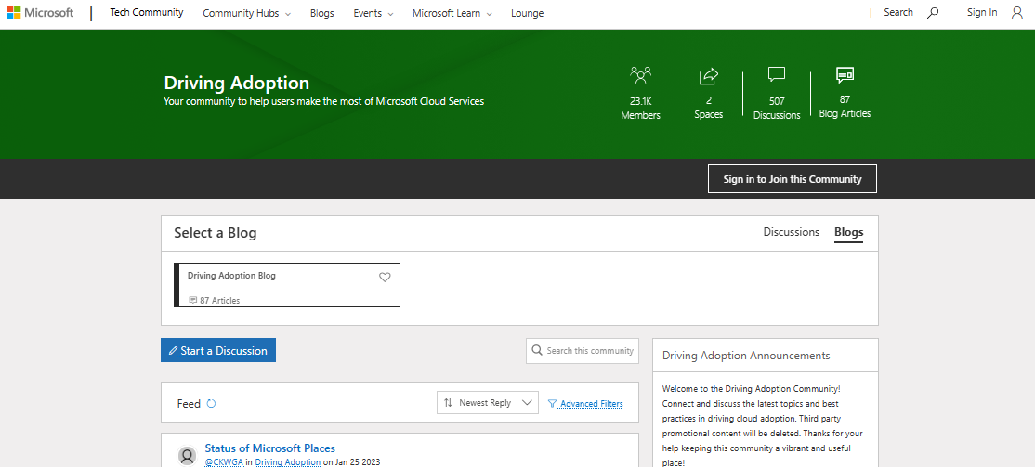
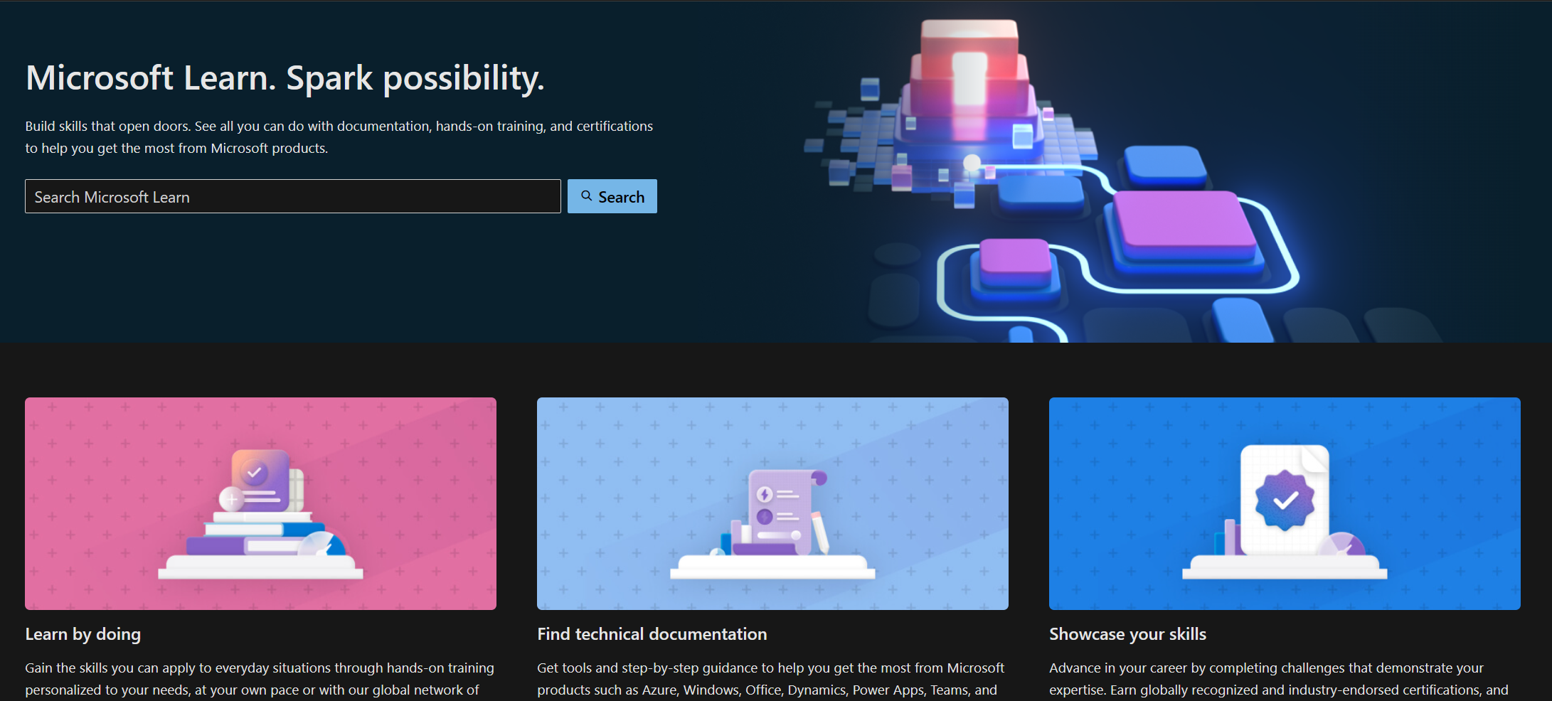
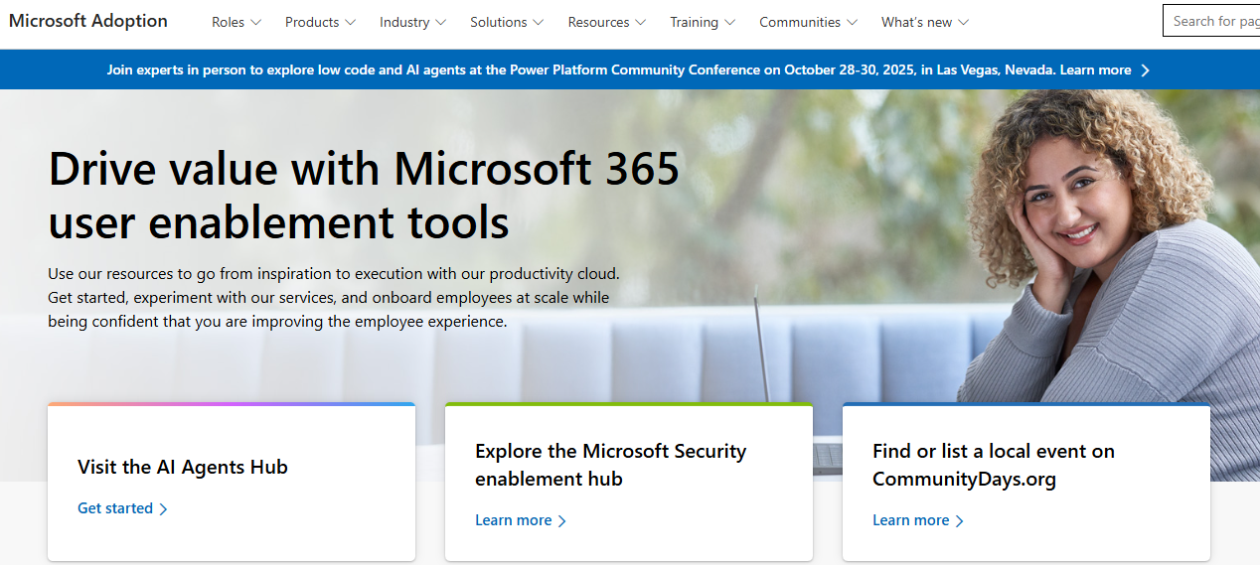
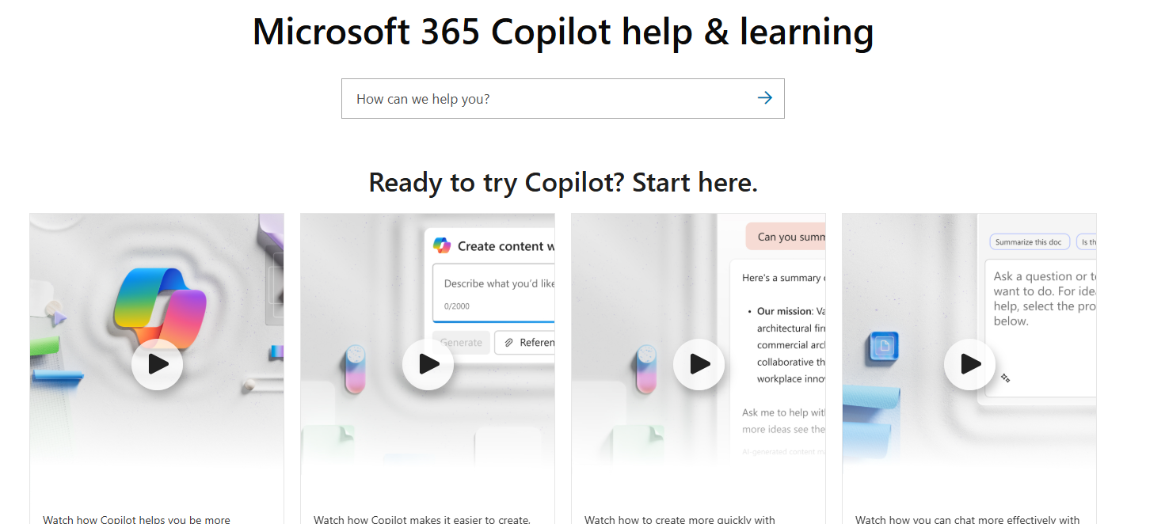
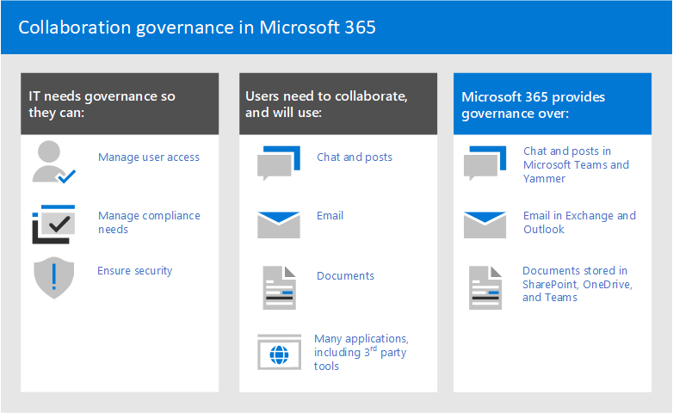
Bookmark Microsoft enablement resources
Join Driving Adoption Tech Community
Microsoft Learn
Microsoft Adoption Hub
https://aka.ms/DriveAdoption
Collaborate, share, and learn from experts
https://learn.microsoft.com
Technical documentation for developers
and IT professionals
https://adoption.microsoft.com
Resources to help you drive adoption
of Microsoft services
Microsoft Support
Teamwork governance
Join our communities
Utilize our resources
Achieve your goals
http://support.microsoft.com/copilot
Access FAQs and user help and learning
https://aka.ms/TeamworkGovernance
Collaboration governance guidance
for Microsoft 365
Notes:
Bookmark these helpful links to enablement resources and communities to help you achieve your goals.
Join the Driving Adoption Tech Community to collaborate and learn from other experts.
On the Microsoft Support page, you’ll find FAQs and self-driven user help.
Teamwork governance is where you can find collaboration governance guidance for Microsoft 365.
And as we’ve already discussed, our Microsoft Learn site and Adoption Hub are great resources for developers, IT professionals, and driving adoption.

Slide 56
Deliver Impact
Shared activity
Foundational tasks
Copilot specific tactics
Review success measures and user survey results
Conduct feedback and reporting analysis
Deliver extended training and adoption support
Iterate user experience strategy
Gather and amplify success stories
Measure Copilot impact
Ensure progressive AI skilling with training tools
Identify additional optimization scenarios
Expand Microsoft Viva for Copilot Enablement tactics (if available)
Review feedback with
AI Council and stakeholders
Notes:
Delivering impact is without doubt one of the most important aspects of change management on the implementation of copilot.
This section discusses foundational tasks such as customer success criteria, feedback and reporting, training and adoption support, as well as iterating the user experience strategy and success stories.

Slide 57
Review success criteria
Validate key performance indicators (KPIs) that are improving based on Copilot skills.
Choose criteria to help you show the impact Microsoft 365 Copilot is having on the organization.
Use the end user surveys, listening systems, product feedback, and Champion insights to gather sentiment, risks, and issues.
Leverage Microsoft reporting for further pattern analysis.
  *Based on observation and research from early Copilot customer implementations.
Notes:
This is a great place to review your plan and:
Validate KPIs that are improving
Choose which criteria shows impact of Microsoft 365 Copilot in the organization
Utilize surveys, feedback, and Champion insights to understand the sentiment and any risks or issues that arise
And leverage Microsoft reporting for further pattern analysis.

Slide 58




Review your progress
The enablement outcomes matrix
Organizational
Cultural
Tangible measures
=
Change
quotient
Individual sentiment
Prioritize the section of outcomes that are most important
for your business
Simplify your investment strategy in adoption activity against these outcome segments
Use these dimension to ascertain where you have resource
or skills gaps in your organization to achieve your goals.
Individual
Tangible
Notes:
Reviewing progress includes looking at the "change quotient" – an individual's or organization's ability to adapt to change effectively. It measures how well individuals and organizations can manage and thrive in changing environments.
The enablement outcomes matrix is a tool used to map out and measure the success of user enablement efforts. It helps in identifying key actions and best practices for the user enablement workstream, educating on the user enablement framework in the context of the overall implementation, and delivering guidance for using Microsoft-provided tools throughout the user enablement lifecycle.
This matrix includes foundational or individual learning, organizational approach, cultural prioritization, and tangible measures. Each phase is designed to ensure a smooth transition and maximize the benefits of AI adoption. Customers will need to prioritize outcomes important to the business, simplify their investment strategy against these outcomes, and use this to ascertain where they have resource or skills gaps in the organization.

Slide 59
Enablement outcome examples
Assemble Your Team
Organizational
Cultural
Business process
Individual
Cultural transformation
Employee retention
Talent acquisition
Social engagement
Operational agility
Employee sentiment
Employee recommendations
Customer feedback
Innovation measures, e.g., idea forum contributions
Customer experience impact
Cost savings
Revenue generation
Data security
Process simplification
Use of AI capabilities
Employee morale
Employee productivity
Employee engagement
Idea generation
Questions
How is your organization progressing on these measures?
What is your business transformation process today?
Notes:
Here we have enablement outcome examples that you can use to discuss the organizational, cultural, business process, and individual outcomes that you can use as your success criteria. These are just a few examples to get the wheels turning and the conversation started.
How is your organization progressing on these measures?
What is your business transformation process today?
These can really get you thinking about what you need when assembling your team and making sure you have the right people for your success criteria.

Slide 60
Share with technical team and stakeholders
Identify common themes
Identify opportunities for expansion
and extension
Validate support scenarios and guidance
Identify success stories
Conduct success/challenge analysis
Categorize issues: technical, enablement, strategy or communications, other
Analyze feedback
Notes:
When analyzing feedback with your technical team and your stakeholders, make sure that you're identifying common themes, opportunities for expansion, and success stories, and validating support scenarios and guidance as well as conducting success and challenge analysis.
Categorize your issues in buckets like technical, enablement, strategy, or communications. This will make it easier to decide who will take what feedback and run with it.

Slide 61
Service Health Reviews (SHR) components
Shared activity
Performance
Leadership, technical, user enablement teams, and business stakeholders contribute to a periodic Service Health Review to:
Gain insight from the AI transformation journey progress
Identify risks, issues and potential mitigations
Identify opportunities for expansion
and further optimization
Highlight success stories
This process is critical to the overall
success of the long-term transformation
and realizing business value.
Risk mitigation
Feedback analysis
SHR
components
Roadmap planning
Incident review
Success stories
Notes:
Service health reviews are where different teams come together on a regular basis to review the insights from their progress;
To identify risks or mitigations;
To identify opportunities for expansion or optimization,
to highlight success stories,
and to promote overall success of your customer’s long-term transformation.
This should be the main touchpoint for the overall project team including leadership, technical, and user enablement teams, and business stakeholders.

Slide 62
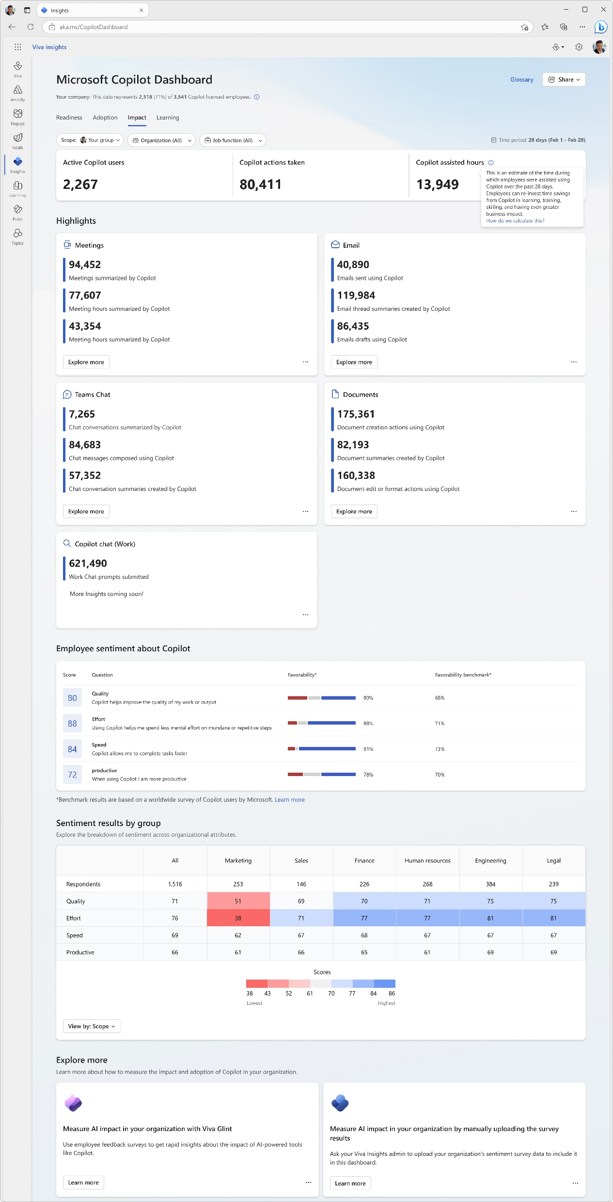
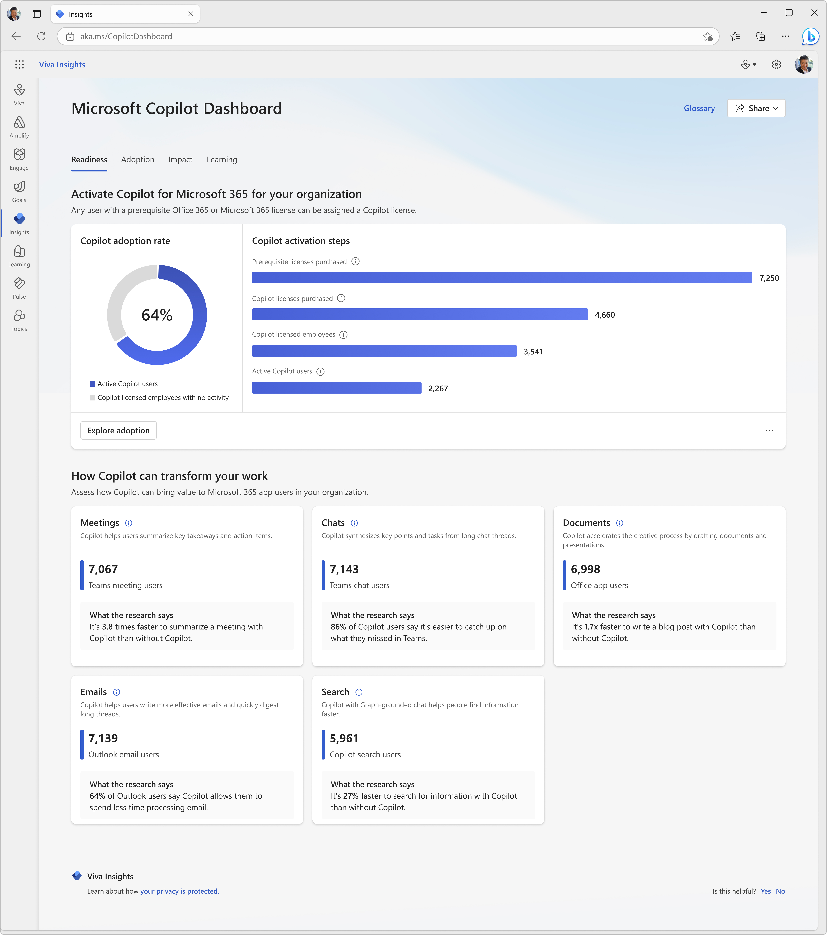

Copilot Dashboard
Measurement
Measure Copilot adoption and impact
Pre-built dashboard for business leaders to prepare for their Copilot rollout, understand and drive usage and adoption, and measure the impact of their investments.
Access directly at aka.ms/CopilotDashboard
Readiness tab to see licensing and copilot activation status across the tenant
Adoption tab to see Copilot trends and usage down to the app feature level, with filters to drill down by group, organization, and job function.
Impact tab to view Copilot actions by productivity categories, Copilot assisted hours and related value calculator and how Copilot usage is correlated with behavioral patterns in your business. Sentiment data from uploaded survey results is also available.
Learning tab for research and best practices to inform your AI journey
Use the Copilot Dashboard metrics eBook to help understand and interpret the data
Notes:
Use the Copilot Dashboard, powered by Viva Insights, to access usage reports and analyze data to understand trends and measure impact.

Slide 63
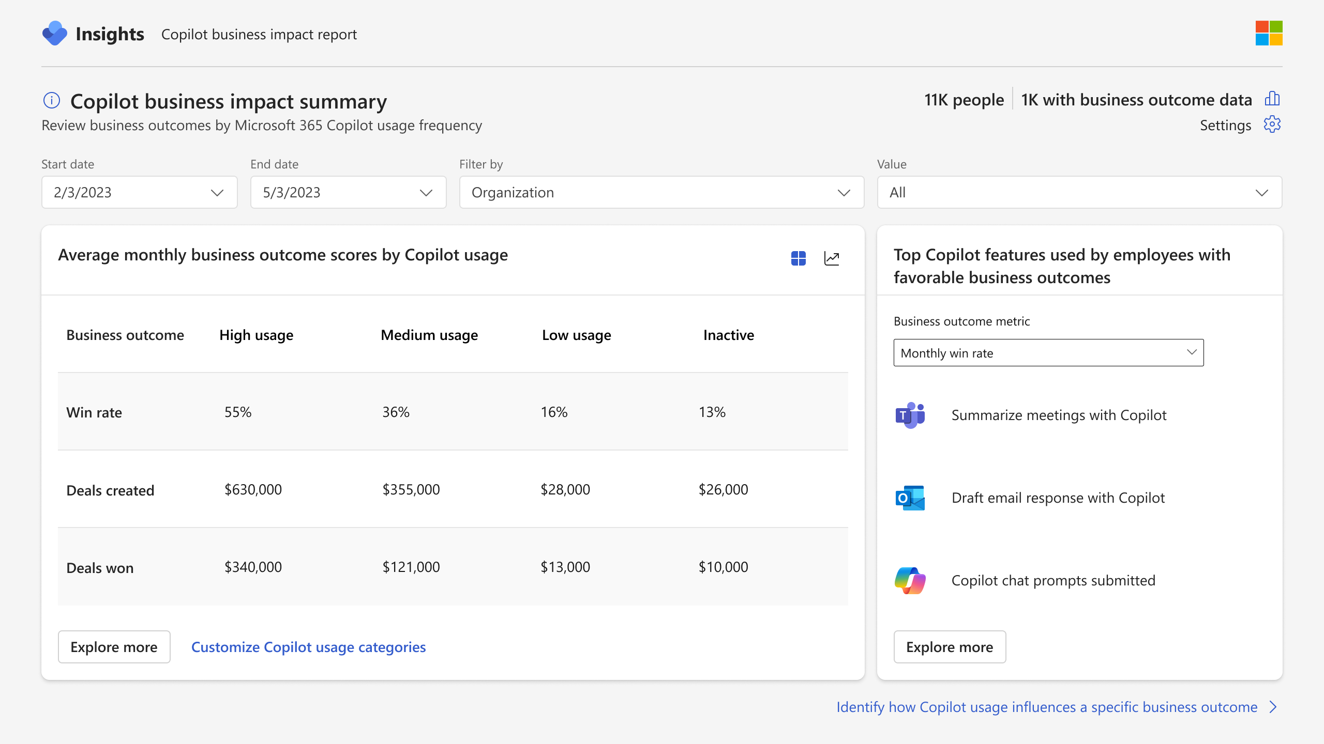
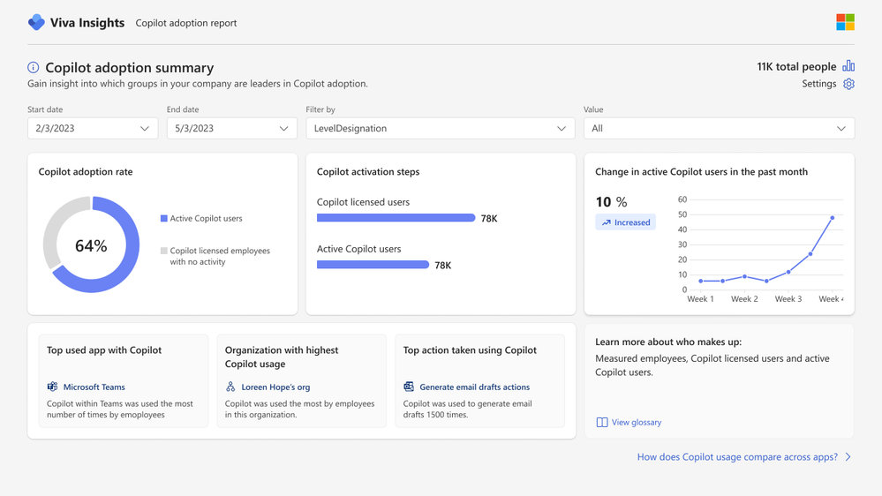
Viva Insights advanced impact reports
Measurement
  Included with Microsoft 365 Copilot
  Copilot business impact reports
Measure the value of Microsoft 365 Copilot with your key business metrics.
See setup details
  Advanced adoption and impact reports
Get a deeper look into Microsoft 365 Copilot adoption and impact trends with a customizable, prebuilt report.
Notes:
Viva Insights now comes included with your Microsoft 365 Copilot license.
Business impact reports:
Understand how Copilot usage relates to business outcomes in a Power BI report template
Customize your analysis for any function with your KPIs from your business data
Identify best practices based on what Copilot activities lead to successful business outcomes
Pinpoint opportunities to improve low Copilot usage to improve adoption and impact
Advanced M365 Copilot adoption report:
Understand how Copilot usage is trending across groups, apps and more.
Includes a dynamic date slicer, advanced filters and groups, trendlines, ability to customize active usage definitions and highlight section that calls out top Copilot actions.
Pull usage data older than 28 days with dynamic time ranges.
Advanced M365 Copilot impact report:
Tailor your Copilot impact report with advanced capabilities to get a deeper look into impact areas.
Compare collaboration patterns across groups or before and after Copilot usage.
Includes dynamic date slicer, Copilot assisted hours and value calculator, group comparisons, and the ability to customize active usage definitions.
Pull usage data older than 28 days with dynamic time ranges.

Slide 64
Extend & optimize
Shared activity
Identify new high value scenarios
Gather data from service health reviews
Prioritize via AI Council and leadership engagement
Skill/acquire talent for extensibility opportunities
Explore
Understand Copilot Studio capabilities
Build, automate and administer copilots
Select extensibility scenarios
Expand
Scale Copilot users and skills
Extend throughout organization
Identify high value user cohorts for advanced skill building
Optimize usage patterns
Extend
Notes:
The last phase of the implementation framework is to extend and optimize Copilot within the business.
This can mean different things to different organizations. As you explore, you should identify new high value scenarios where your users can benefit from using Copilot for Microsoft 365 in a more specified capacity. This knowledge can be gained through service health reviews, leadership engagement, and identifying talent and skills for extensibility opportunities.
You can expand to understand Copilot Studio capabilities by building, automating, and administering your own custom agents for their specific scenarios.
Also consider extending Copilot to scale throughout the organization. Identify high value user cohorts for advanced skill building, but also make sure that you are extending what was done in this Champion group throughout the organization, optimizing the usage patterns they've discovered along this Copilot journey.

Slide 65


Extended view: Designing scenarios using the
Modern Collaboration Architecture (MOCA) Framework
adopt attention-harnessing
contains essential
supported by
Person
Focus areas
Capability/needs
Microsoft 365 apps
Behaviors
Values
Essential elements that enable people to get work done. Performing the capability/needs enables people to accomplish their individual, team, community and organizational tasks.
Organizational
Cultural Values
#PeopleFirst
Foundation focus areas provide an essential foundation for people to develop strong collaboration practices.
To address the specific capability/needs of people when they operate as individuals, teams, community, and organizational focus areas, specific Microsoft 365 applications can be used to accomplish the required tasks.
Behaviors that enable attention to be harnessed to create focus and flow for people to get work done. If attention-harnessing behaviors are not intentionally created, attention-distracting behaviors get adopted, resulting in a drop in people’s effectiveness and a negative impact on collaboration across the team, and the wider organization.
An organization’s culture is comprised of the behaviors of groups of people. When we help individuals adopt attention-harnessing behaviors, that in return contributes to the positive culture of an organization.
It’s all about people.
A person’s effectiveness can be increased by getting them to adopt the right ‘attention-harnessing’ behaviors.
Extended focus areas enable improvement of business improvement and differentiation to focus on developing a culture of continual improvement.
work within
are enabled by
contribute to the wider organizational
Notes:
Our attention is the most precious commodity we humans have. Technology itself can help us focus or be the cause of distraction.
Here at Microsoft, we aim for organizations to use our technology to harness attention.
Thus, we have designed the MOCA to address two key challenges:
1.To help organizations drive digital culture change across the organization enabled by good attention management practices.
2.To address the “What am I accomplishing?”, an evolution from the “which tool when?” question for the Microsoft 365 collaboration suite, demonstrating how all the different tools integrate to enable people to work differently across the organization.
Over time people get into a rhythm, and when they get to work, they start doing things they are good at without too much thinking.
We often get our morning coffee from the same café, walk the same route from the car park to our desk or lockers and then when we get to our devices, start our working day by checking our emails.
These behaviors have become so ingrained in our routine that we’re on autopilot.
Habits have a tremendous impact on individual and organizational productivity, as well as our personal lives.
This makes it fundamental that we activate and drive attention-harnessing habits using technology.
Adoption is not about features and functionalities, it is about habitual usage of new ways of working, that delivers tangible value.
Organizations have a responsibility to drive behaviors that harness and not distract attention.
Microsoft 365 Copilot can be used in a way that shortens the amount of time it takes to do our normal tasks, thereby decreasing the chances of distraction.

Slide 66

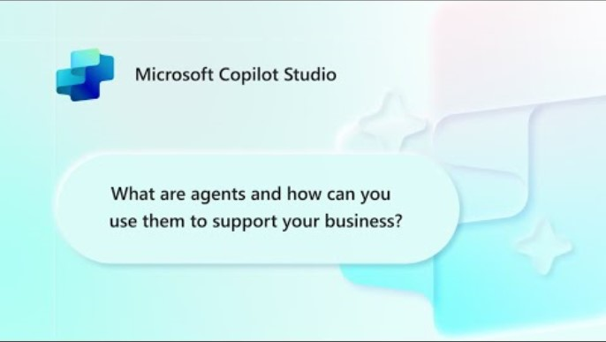
What are agents?
For other helpful videos – Visit our Mastering Copilot Studio video series
Disclaimer: As of June 2025, the agent pane has transitioned to the left side of M365 Copilot

Slide 67
As business demands rise, leaders see agents as the way forward
53%
82%
Of leaders say productivity needs to increase
Of leaders expect to use agents to meet the demand for more workforce capacity
¹2025 Work Trends Index
Notes:
In today’s labor market, there’s more work to be done than there are people to do it
This results in business challenges like long customer wait times, salespeople being unable to follow up with potential leads, and employees being stretched over competing priorities.
That’s why 82% of leaders expect to use agents to handle rising business demands

Slide 68







Choose your path
Whether you’re a beginner or a pro, agents enhance Copilot to better fit your business needs
Start with a pre-built agent
Build an agent from scratch or from a customizable template
Bring your own agent
Researcher
Analyst
Meeting Agent
Lead
Prediction
Automated Contract Review
Document Compliance
M365 Agents SDK
Azure AI Foundry
Visual Studio
Looking for immediate impact?
Pick from a variety of pre-built agents designed to automate common business tasks in the Agent Store or
Microsoft 365 apps.
Have a specific vision?
Quickly build your agent using natural language in Copilot Studio—through the embedded Copilot Chat or the full experience. Start faster with a customizable template tailored to your business.
Looking to build on what you have?
Bring existing agents into Copilot Studio
to unlock the benefits of a fully managed enterprise-grade platform that is governed, compliant, and extensible.
View more in the Agent Store. Copilot Chat,
and M365 apps.
View more in Copilot Chat and Copilot Studio
View with M365 Agents SDK, Azure AI Foundry,
or where you build your agents
Beginner
Agent Pro
Notes:
Get inspired by a wide selection of pre-built agents that are ready to configure and deploy, by building your own, or bringing your own agent.

Slide 69
Start with a pre-built agent

Slide 70










Agents in Microsoft 365
Researcher
Analyst
Skills Agent
Surveys Agent
Knowledge Agent
Advanced reasoning
Advanced reasoning
Generally available
Generally available
Frontier
Frontier
Private Preview
Meeting Agent
Interpreter
Channel Agent
Project Manager
Community Agent
Public preview
Generally available
Public preview
Public preview
Public Preview

Slide 71
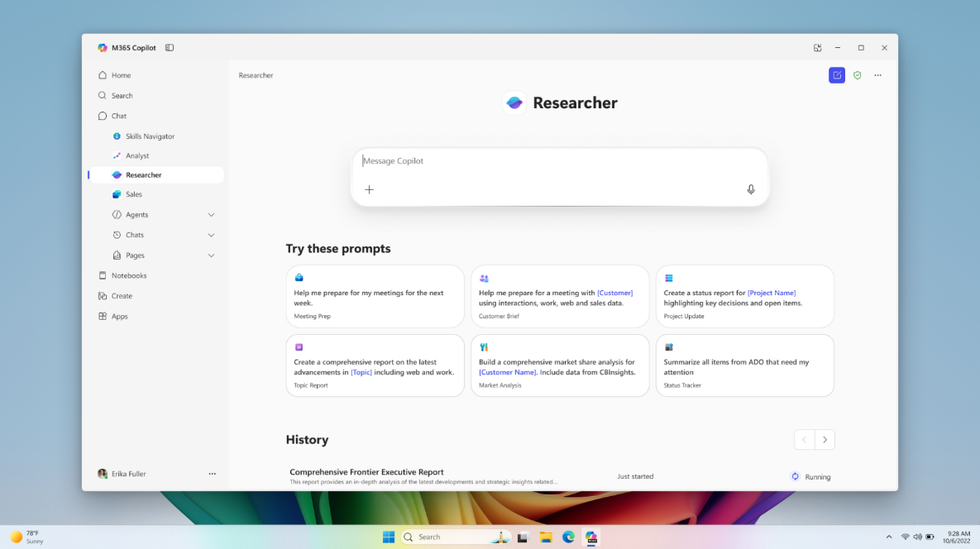
Researcher
Copilot Chat
Researcher gives organizations the capability they’d expect from a highly paid strategist or researcher.
Combines the most advanced deep reasoning models with Copilot Chat’s web- and work-grounding, as well as its agent ecosystem.
Provides well-reasoned responses to complex prompts with the data that matters most.​
Gives users a thought partner that can perform advanced reasoning grounded in their unique context.
Gives organizations on-demand access to the types of work they typically expect from highly paid employees.
Generally available
Notes:
The Researcher Agent gives organizations the capability they’d expect from a highly paid strategist or researcher.
By bringing company data from the Graph and third parties to the latest deep reasoning models, and by giving this agent the ability to call other agents, companies can ask the Agent to do the work that underlies the most value-add operations, from product strategy to research to strategic planning.
End users use the prompt-based model to ask a question whose response builds off internal and/or external data, answer a few clarifying questions to help guide the Agent’s research, adjust the Agent’s proposed research plan, then in a matter of minutes will receive an in-depth report in a Copilot Page.
From there, they can use multi-turn prompting to edit or append that report, and can dynamically edit or share via the page.
COMPETITIVE DIFFERENTIATION
The Researcher Agent builds off the models that’ve driven significant excitement in the market by adding the key to unlocking value in organizations—proprietary, organizational data. This data goes beyond a file or even a large database, as it includes the collaborative data that makes up an organization’s processes and the metadata + organizational data that defines the organization itself. By giving Researcher the ability to call other Agents, it serves as a centralized tool to accomplish even the most complex and nuanced business challenges. With this added data, the Researcher Agent is unique in its ability to reference the most relevant data while responding with contextually appropriate responses.

Slide 72
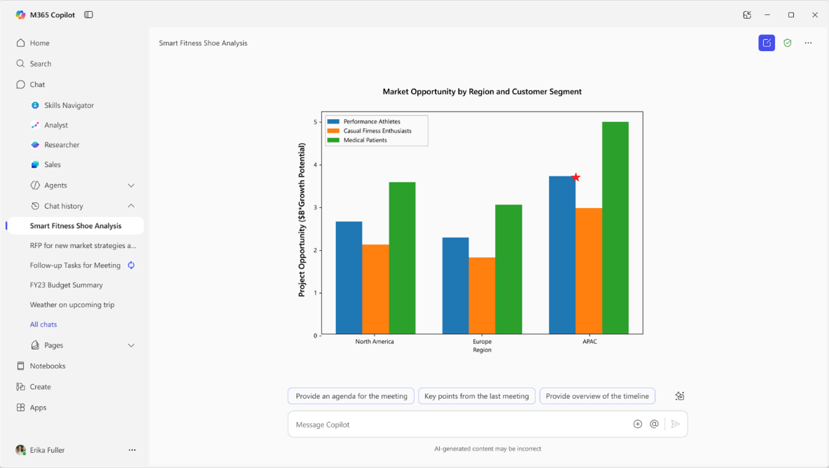
Analyst
Copilot Chat
Analyst thinks like a skilled data scientist, so you can go from raw data to insights in minutes. ​
Built on OpenAI’s o3-mini reasoning model and optimized to do advanced data analysis at work.
Analyst uses chain-of-thought reasoning to progress through problems iteratively, to refine its reasoning and provide a high-quality answer.
Runs Python to tackle your most complex data queries—you can view the code it’s running in real time to check its work.
Generally available
Notes:
Analyst is one of the first reasoning agents of its kind in M365 Copilot, placing sophisticated data analytics capabilities right at your fingertips.
Powered by our advanced reasoning model post-trained on OpenAI o3-mini, Analyst uses chain-of-thought reasoning to provide a high-quality answer to data analysis questions.
It progresses through problems iteratively, taking as many steps as necessary to refine its reasoning in a process that mirrors human analytical thinking.
It can even run Python to tackle your most complex data queries—and you can view the code it’s running in real time to check its work.
For example, you can use Analyst to turn raw data scattered across multiple spreadsheets into a demand forecast for a new product, a visualization of customer purchasing patterns, or a revenue projection.
COMPETITIVE DIFFERENTIATION
Traditional LLMs have historically jumped too quickly from problem to proposed solution while failing to adjust to new complexities or gracefully recover from mistakes. With the capability to generate and execute code at every step within its reasoning trajectory, this agent excels at incremental information gathering, constructing hypotheses, course correction, and automatic recovery from errors.
The best product comparisons are ChatGPT Advanced Data Analysis, and Google Data Science Agent (not apples to apples given it’s not integrated in Workspace).

Slide 73
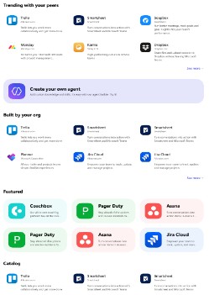
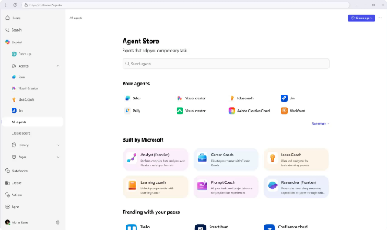
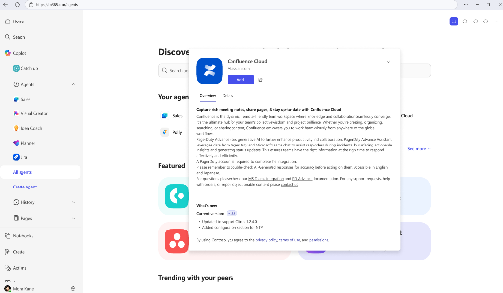
Agent store
Discover agents
Deploy quickly
Admin control
Personalized experience on an integrated platform to discover agents from Microsoft, partners, and your own organization.
Accelerate results with ready-to-deploy agents that help boost efficiency and enable smarter decisions.
Agents are validated for security, compliance, and performance, and IT retains full control and oversight.
Notes:
Agent Store, also accessed through the Copilot app, is an agent marketplace featuring agents from Microsoft, partners and customer organizations. If your org builds an agent it wants to deploy org wide in Copilot, Agent store is how you do it.
Its immersive and personalized experience can help customers find and use agents to transform work processes and elevate productivity. You can also share agents with colleagues via Copilot Chat or other Microsoft 365 Copilot endpoints to boost collaboration.
All agents, whether developed by Microsoft or partners, undergo strict validation processes to meet enterprise standards for functionality, security, and compliance.
IT admins have full visibility and control over how agents are deployed in their organization.

Slide 74





Microsoft 365 Copilot
Training and documentation by phase
Get ready
Onboard & engage
Deliver impact
Extend & optimize
Copilot Experiences Explained
(11 mins)
Leading in the Era of AI:
Creating an AI Council
Discover how to drive enablement of Microsoft 365 Copilot in your organization (2.5 hrs)
User Experience Strategy template
Copilot Prompt Gallery
(including app specific guidance)
Leading in the Era of AI:
It’s about Trust
Learn about Copilot prompts
Empower your workforce with Microsoft 365 Copilot Use Cases
(7 business group use cases)
Craft effective prompts for Microsoft 365 Copilot (2 hrs)
Get better results with
Copilot Prompts
Edit a Copilot prompt to
make it your own
Share your best prompts
Modern Collaboration Architecture people-centric scenario guidance
Video
Docs
Course
Docs
User Enablement
Article
Tool
Course
Course
Article
Article
Article
Article
Article
Prepare your organization for Microsoft 365 Copilot (1.5 hrs)
How Microsoft 365 Copilot works (11 mins)
How to get ready for Microsoft
365 Copilot (9 mins)
Data, Privacy, and security for Microsoft 365 Copilot
Microsoft 365 Copilot requirements
Get started with Microsoft 365 Copilot (2 hrs)
Admin steps to get ready for Microsoft 365 Copilot (46 secs)
Apply principles of Zero Trust to Microsoft 365 Copilot
Enable users for Microsoft 365 Copilot
Microsoft 365 Copilot Documentation
Copilot Dashboard implementation
Extend Microsoft 365 Copilot
Create copilots with Microsoft Copilot Studio (4 hrs)
Optimize and extend Microsoft 365 Copilot (1 hr)
Extend and manage Microsoft Copilot Studio copilots (2 hrs)
Build connectors and plugins for Microsoft 365 Copilot (3 hrs)
Course
Course
Docs
Docs
Video
Video
Docs
Technical Readiness
Course
Video
Docs
Course
Docs
Docs
Course
Docs
Course
Notes:
This is an appendix slide with hot links to the relevant training and documentation by implementation phase.

Slide 75
Links to learn more (1 of 2)
Copilot Readiness Hub
What is Copilot?
Introducing Microsoft 365 Copilot
User help and learning
How Copilot works
How Microsoft 365 Copilot works: Microsoft Mechanics video
Semantic Index for Copilot
Microsoft Graph
Microsoft Copilot connectors
Understanding foundational model changes
Privacy
Microsoft’s privacy policy
Microsoft Privacy Statement
Trust Center data protection and privacy
Data, privacy, and security for Microsoft 365 Copilot
Data, privacy, and security for Azure OpenAI Service
Role-based access control
User permissions and permission levels in SharePoint Server
Customer Lockbox requests
Microsoft 365 isolation controls
Data Protection Addendum

Slide 76
Links to learn more (2 of 2)
Data residency and storage
EU Data Boundary
  Website
  Blog
  Documentation
Compliance
Microsoft Compliance
Service Trust Portal
Compliance offering definitions
General Data Protection Regulation (GDPR)
  Full summary
  Short summary
Security
Configure usage rights for Azure Information Protection (AIP)
Universal Licensing Terms for Online Services
Data Protection Addendum
Isolation and Access Control in Microsoft 365
How to prepare for Microsoft 365 Copilot
Learn about Microsoft feedback for your organization
Manage Microsoft feedback for your organization
How to manage Microsoft Search
Microsoft 365 Product Terms
Content management and security in SharePoint, OneDrive, and Teams
Transcription Management in Microsoft 365 Copilot
Get ready for Microsoft 365 Copilot with SharePoint Advanced Management
Microsoft deployment blueprint to implement internal oversharing protections for Microsoft 365 Copilot
Responsible AI
Responsible AI core principles
  Videos
  Documentation
Microsoft Responsible AI Standard
Governing AI: A Blueprint for the Future

